Slide 1
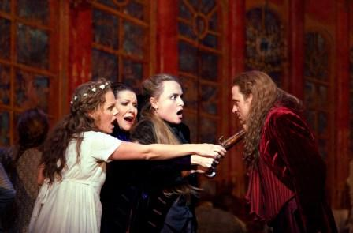
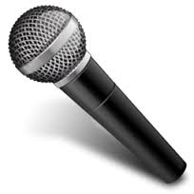
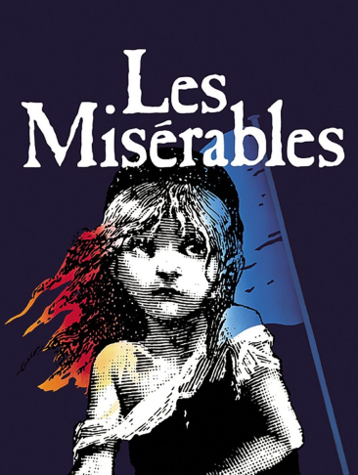
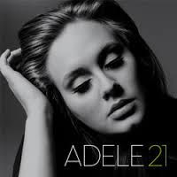
Vocal Music
http://www.youtube.com/watch?v=lExW80sXsHs

Slide 2
Voice Types
Vocal Styles
Vocal Music

Slide 3
What are We Learning Today?
Learning about different Styles of Vocal Music
Develop our knowledge of Vocal Music by looking at different styles

Slide 4
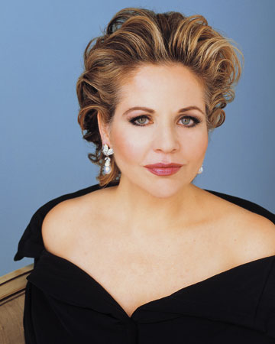

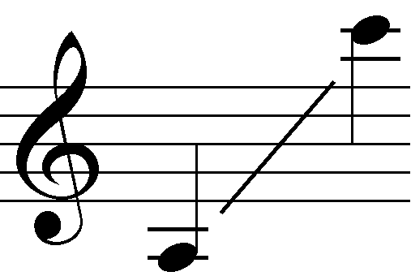
Soprano
High, Florid female voice
Range: A - C

Slide 5
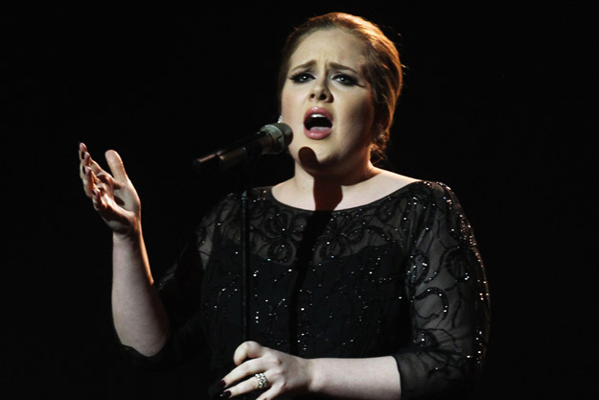
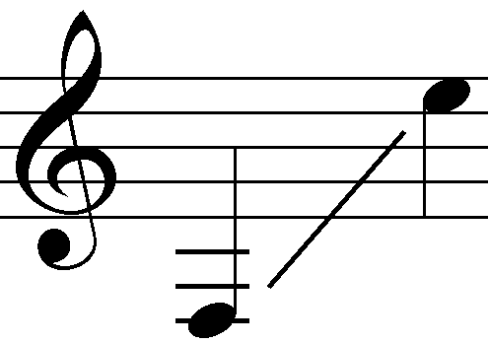
Alto
Lowest Female Voice
Rich, deep tone-
Very different to Soprano!

Slide 6
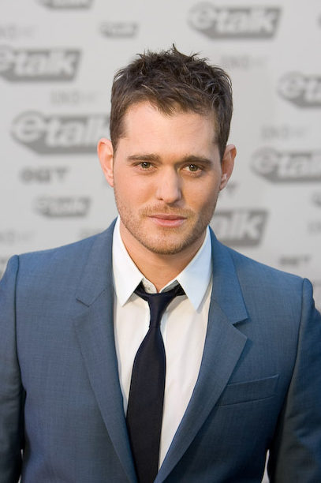
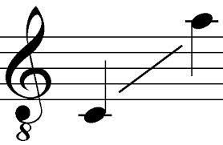
Tenor
Highest Male Voice
Range from C, - C’ (below Middle C)

Slide 7
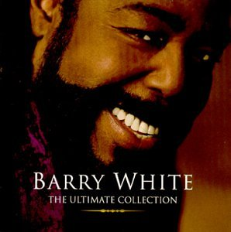
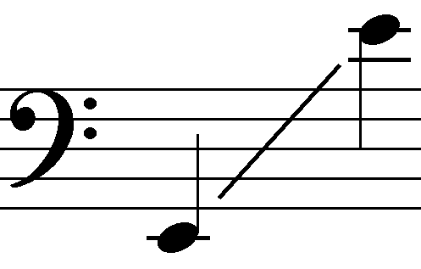
Bass
Lowest sounding male voice
Range: E (2 below middle C)
E (just above middle C)
http://www.youtube.com/watch?v=giVGv_dnmdY

Slide 8


MELISMATIC
Several notes sung to one syllable.
Glo ri-a

Slide 9

SYLLABIC
When you know the notes to sing, you can sing most an - y - thing
Vocal music where
each syllable is given
one note only.
.

Slide 10
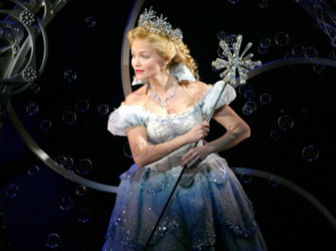
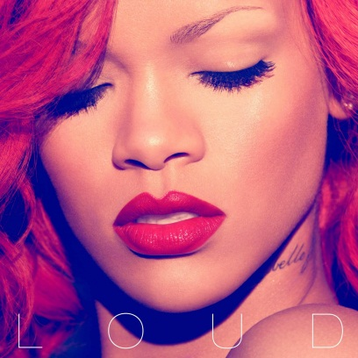
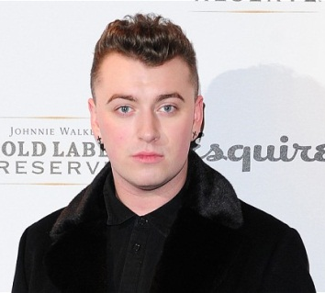

Soprano
Alto
Tenor
Bass

Slide 11




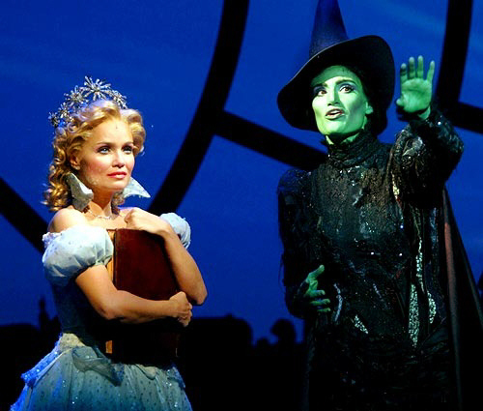


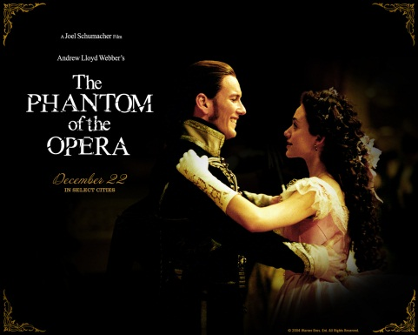
Musical
A musical play which has speaking, singing and dancing and is performed on a stage.
http://www.youtube.com/watch?v=qsYnhVITf9E

Slide 12
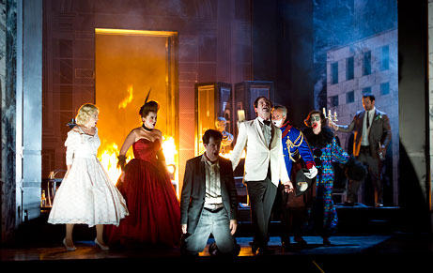
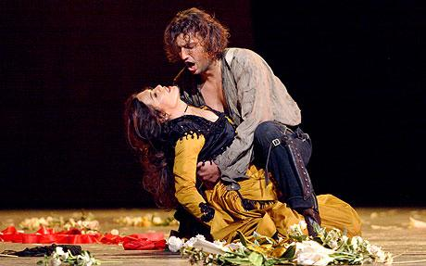
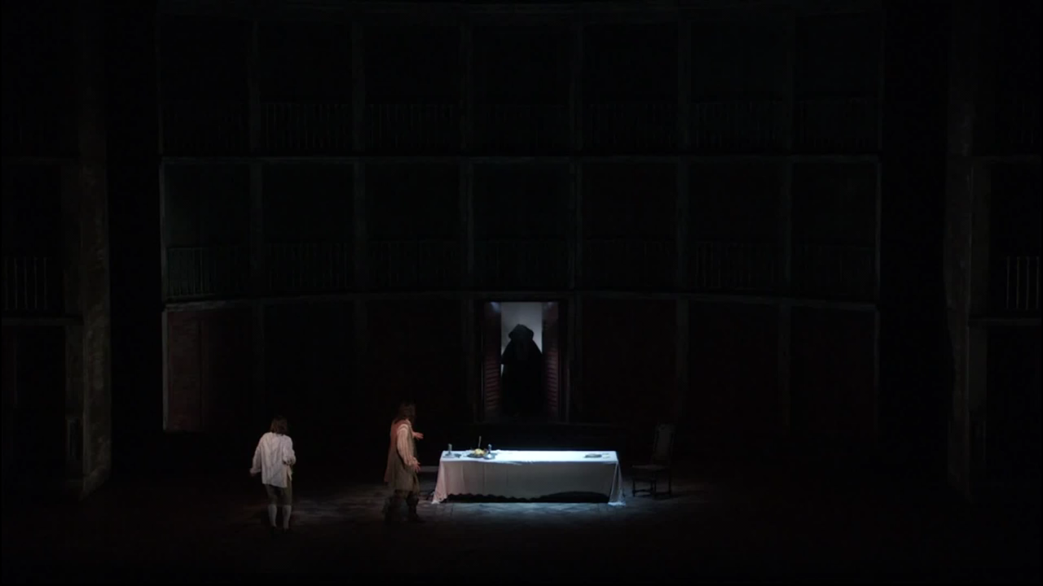
Opera
Sung most commonly in Italian (can also be sung in German)
Telling of fictional story
Features SATB Chorus, Soloists and Orchestra
Performed with elaborate stage design and costumes

Slide 13
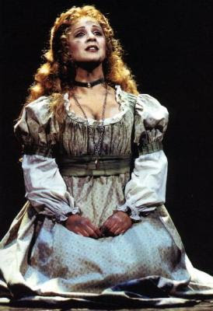
Recitatives and Arias
Within operas and oratorios there are types of songs called ARIAS.
A RECITATIVE is always followed by an ARIA.

Slide 14
RECITATIVE
A short linking passage for a singer ‘half sung, half spoken’. The accompaniment is very sparse.
Think ‘reciting’.
If only this
hadn’t happened…
CHORD
CHORD

Slide 15
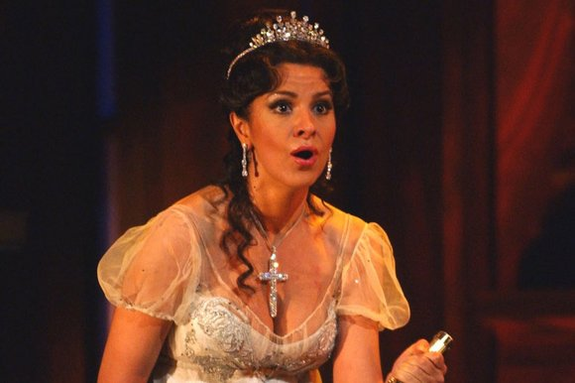
ARIA
A song from an OPERA which shows individual characters emotions.

Slide 16
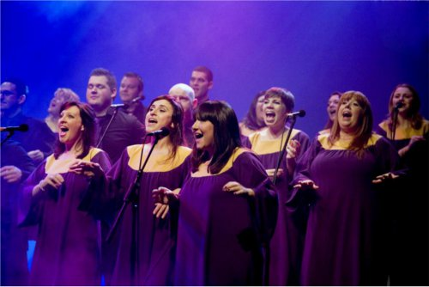
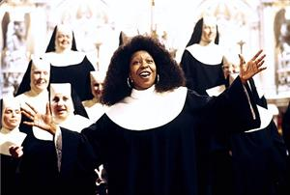
Gospel Music
Music written with religious lyrics
Usually a song praising God
Can feature a Choir and Soloists
Usually sung A Capella

Slide 17
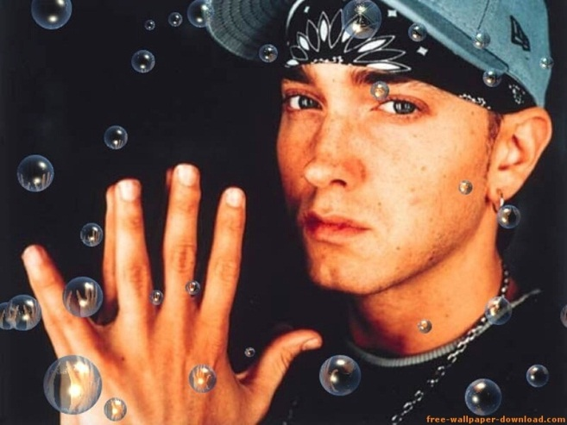
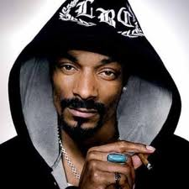
Rap Music
Rhyming lyrics that are spoken and performed in time to a beat. Rapping is popular in hip-hop music.

Slide 18
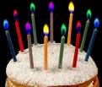

UNISON
Two or more
parts or voices
sounding the
same
“Happy birthday to you, happy birthday to you…”

Slide 19
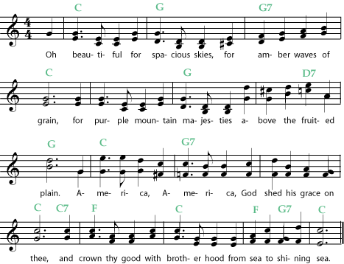
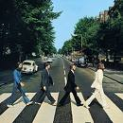
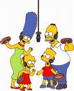
HARMONY
The sound of two or more different notes made at the same time.

Slide 20
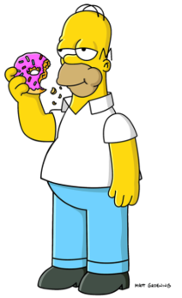
HOMOPHONY
When all of the parts in a piece of music are moving at the same time

Slide 21

POLYPHONY
When all of the parts in a piece of music are moving at different times
Opposite to Homophony

