Slide 1

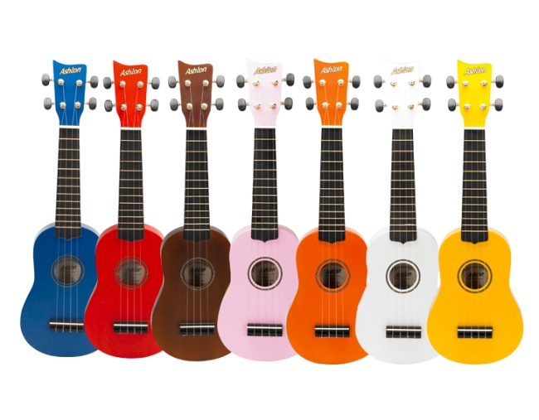
UKULELE
FIRST LESSONS

Slide 2

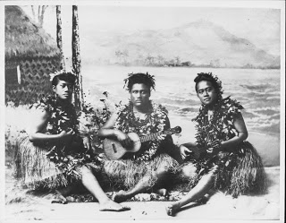
In 1879, a ship called
the “Ravenscrag” sailed
from Portugal to Hawaii.
The sailors brought a small guitar like
instrument with only 4
strings.
The Hawaiians loved the little instrument,
and named it the “UKULELE” which means
“jumping flea” referring to the fast strumming of the right hand!

Slide 3
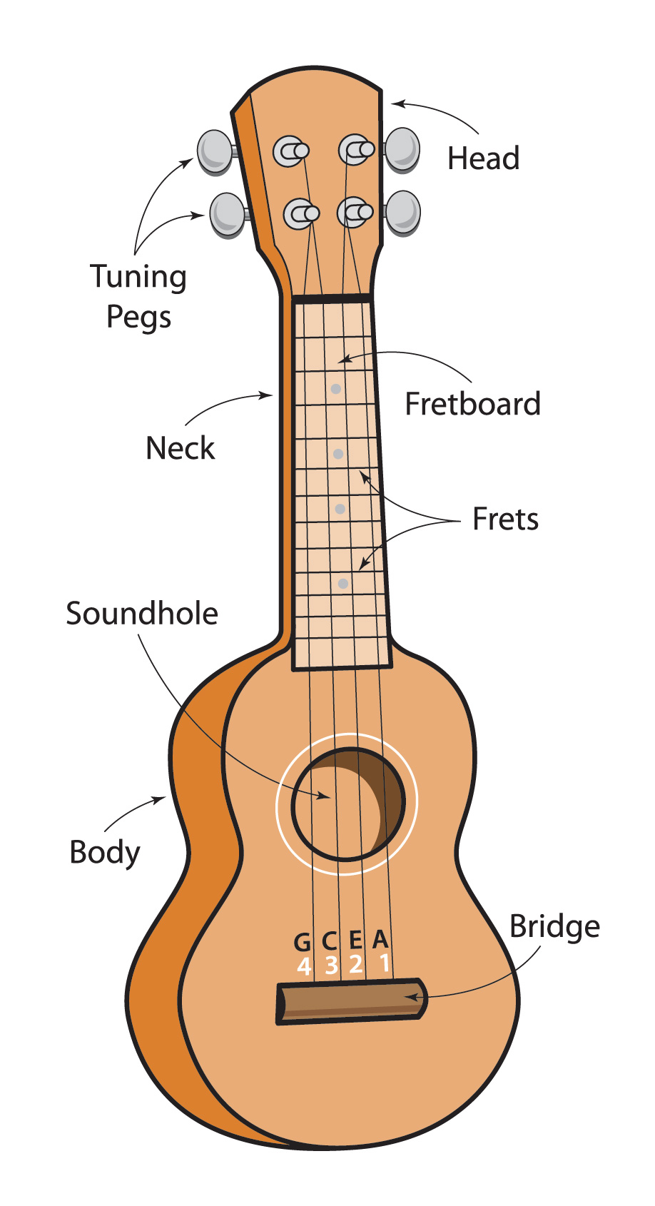

Slide 4
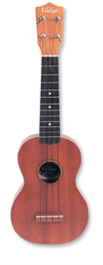
OPEN STRINGS
The strings are numbered
from the floor upwards.
The string nearest your nose is
called “G” and is string 4
The next string down is called
“C” and is string 3
The next string down is called
“E” and is string 2
The string nearest the floor is
Called “A” and is string 1
Pluck the strings with your thumb
from the top down – G C E A

Slide 5
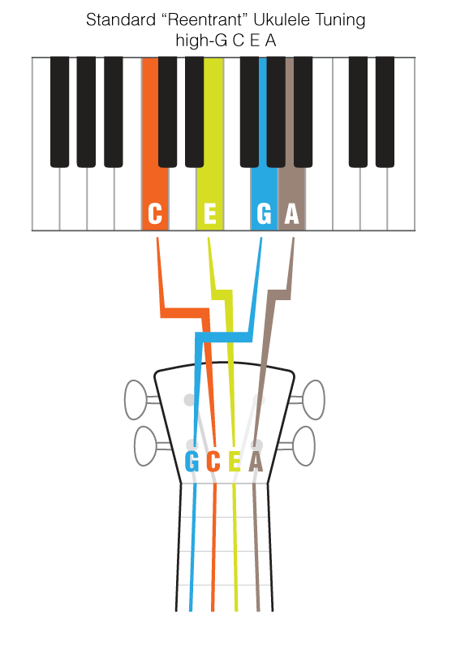
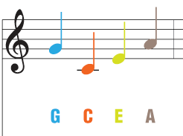
Tuning up your Ukulele...

Slide 6
G C E A
Four strings we play
As we tune our
Ukuleles
Every day

Slide 7
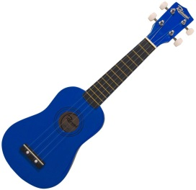
STRUMMING
Point to your nose with
your RIGHT HAND finger
Brush nail of pointing finger
down across the strings
Use NAIL of pointing
finger
PRACTISE
DOWN STRUMS

Slide 8
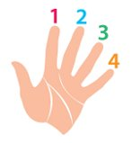
Left hand finger numbers

Slide 9
A Chord is a
group of notes
played at the same
time.
We will be playing
chords which have
4 notes, as ukuleles
have 4 strings.

Slide 10
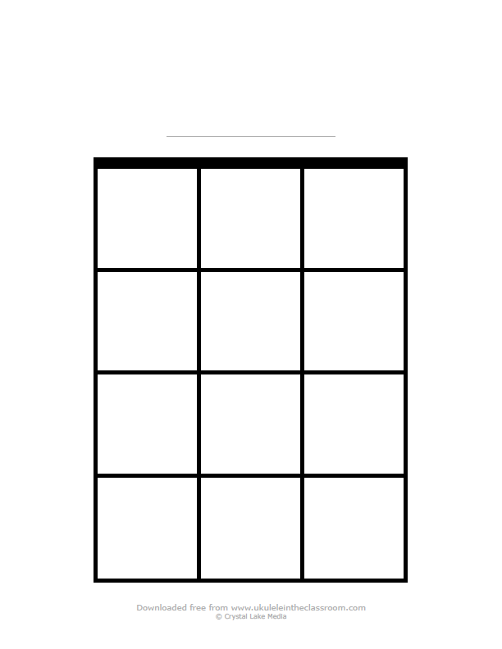
Chord Box
This is just a
drawing of the
top of the
FRET BOARD
Fret
The 4 strings
G C E A
The LEFT hand fingers
Press the strings on the
FRET BOARD

Slide 11
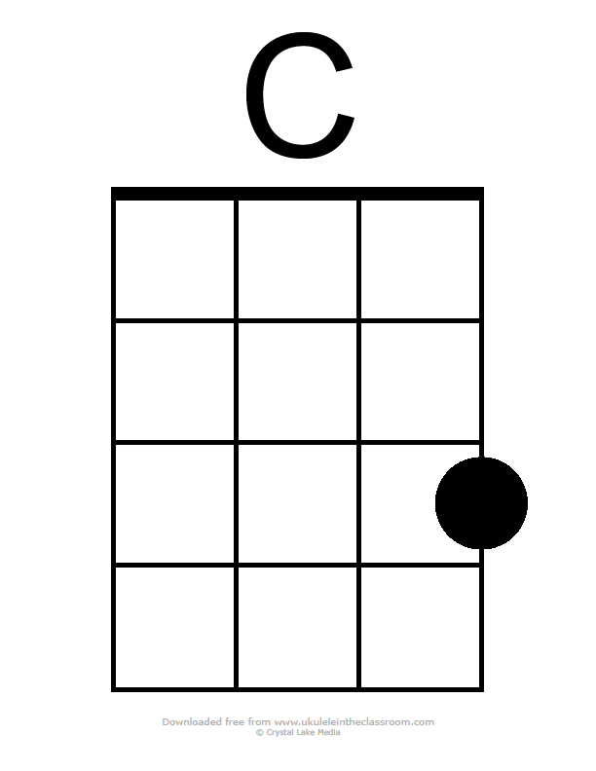
3
RED DOTS - THIRD finger

Slide 12

STRUMMING
Point to your nose with
your RIGHT HAND finger
Brush nail of pointing finger
down across the strings
Practise DOWN STRUMS
on C Chord
3rd finger RED dot

Slide 14


Slide 15

SHUFFLE STRUM
Down up down up down up down up
Te – te te – te te – te te – te
Ten in the Bed – SHUFFLE STRUM
C Chord – Du du du du
(te-te rhythm)
Starting note:“C” open string 3
Revise FRERE JAQUES with a
SHUFFLE STRUM.

Slide 16
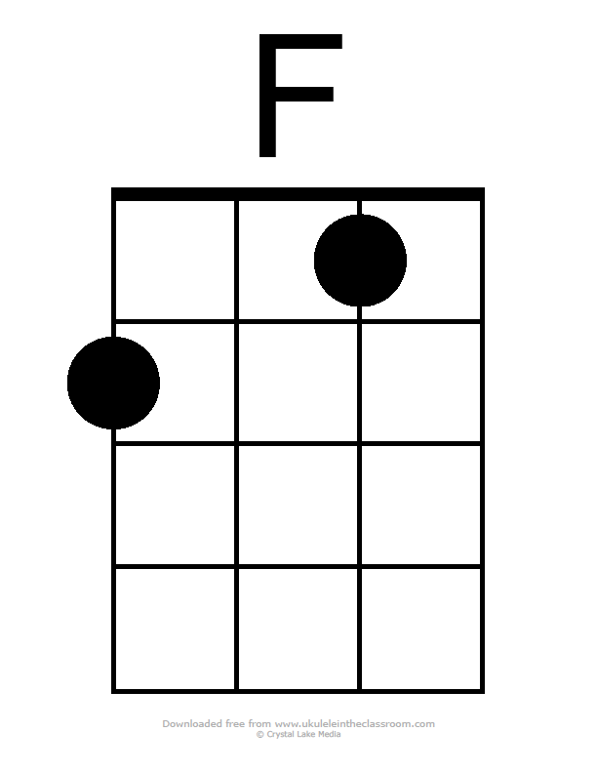
1
2
BLUE DOTS –
First and second fingers

Slide 17
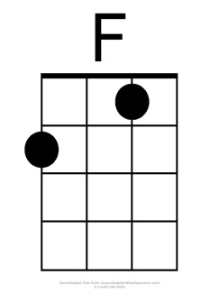
STRUMMING
Point to your nose with
your RIGHT HAND finger
Brush nail of pointing finger
down across the strings
Practise DOWN STRUMS
on F Chord
BLUE dots

Slide 18



X 6
X 8
X 8

Slide 20
SHUFFLE STRUM
Down up down up down up down up
Te – te te – te te – te te – te
Revise ……..
One man went to mow
With
Shuffle Strum
Have you added
“WOOF’s”??

Slide 21
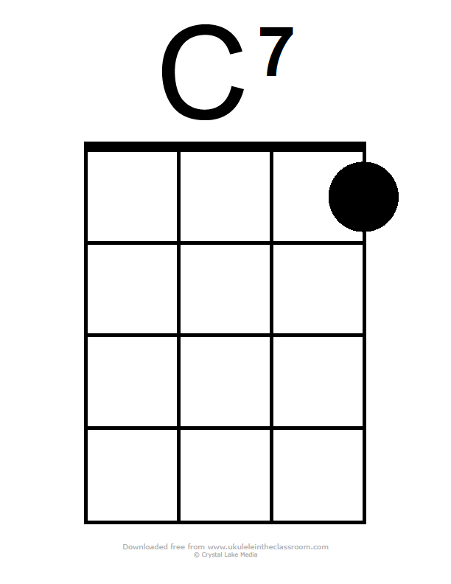
1
First finger-first fret-
first string (nearest floor)

Slide 22
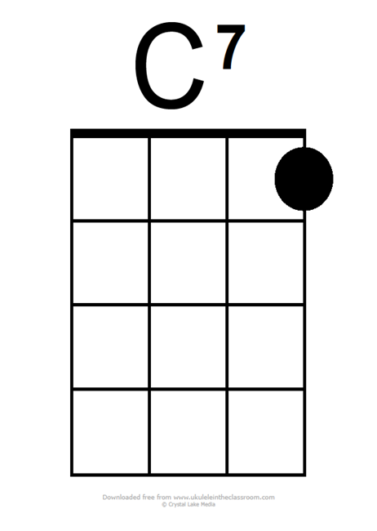
Shuffle strum-Down Up
X 4
X 8
X 8

Slide 23
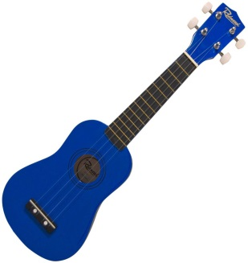
Slow Thumb Strums
Practise slowly brushing right thumb down the strings 4 3 2 1
You can hold the body of the
ukulele with your right hand
Make sure you can hear
each string separately
To give a “harp” effect
The slower, the better…

Slide 24

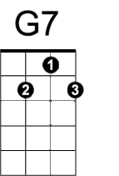

Slide 25
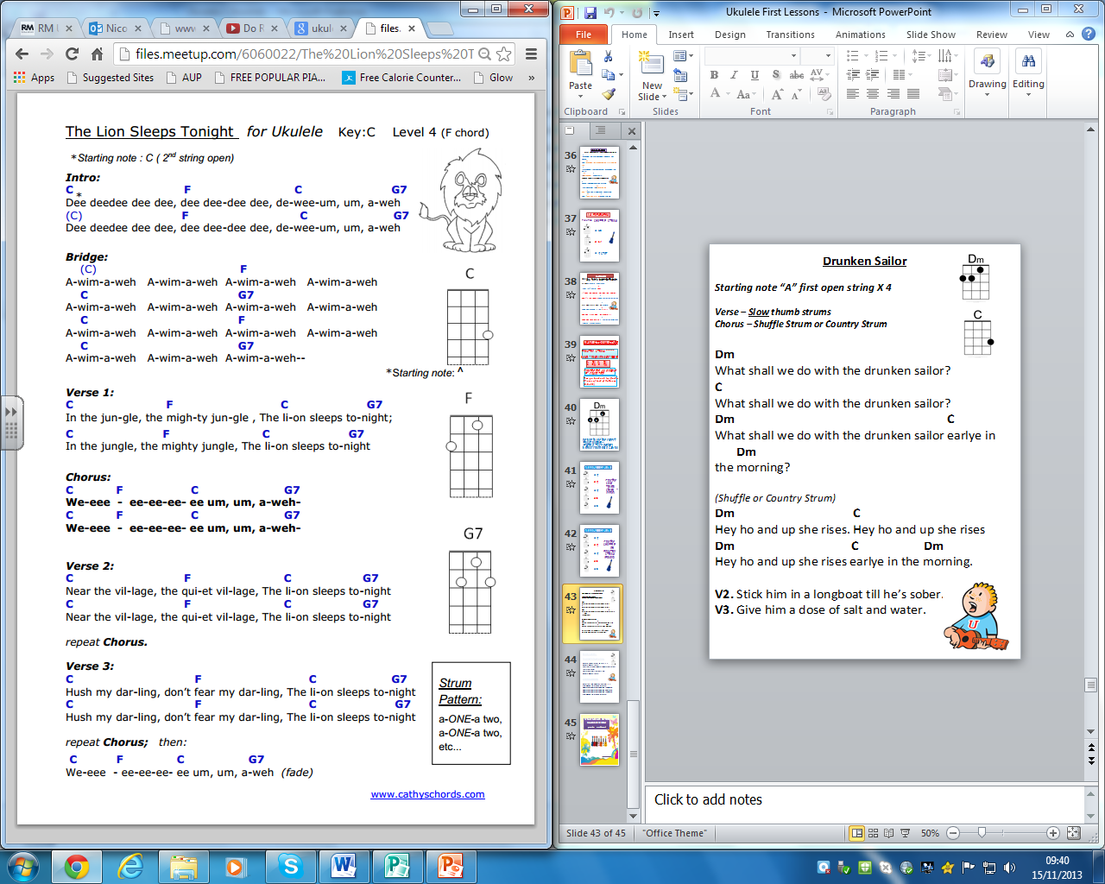

Slide 26
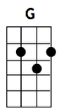
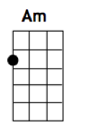
X 6
X 8
X 4
X 4
X 4
X 4

Slide 27
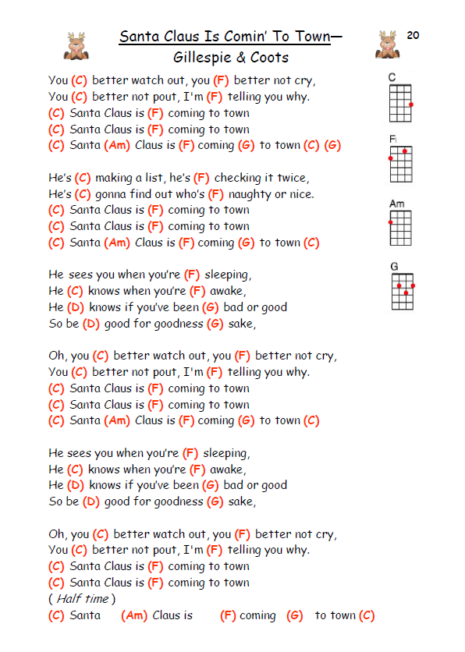

Slide 28




LORD OF THE DANCE
X 4
Practise
slow
thumb
strums -
(Verse)
X 4
X 4
X 2
X 2

Slide 29
LORD OF THE DANCE
X 6
Practise
SHUFFLE
STRUM
(Down-up)
Chorus
X 2
X 4
X 2
Down down down

Slide 30

Lord of the Dance
VERSE: Slow thumb strums: 3 X Open C string to start.
F
I danced in the morning when the world was begun
C7
And I danced in the moon and the stars and the sun
F
I came down from heaven and I danced on the earth
C7 F
In Bethlehem I had my birth
F
Dance then wherever you may be
C7
I am the Lord of the dance said He
F
And I’ll lead you all wherever you may be
C7 F
And I’ll lead you all in the dance said he
CHORUS: SHUFFLE STRUM – Fast DOWN -UP

Slide 31


LA CUCARACHA
Practise SHUFFLE STRUM
X 12
X 16
X 4 STOP

Slide 32
La Cucaracha
3 X Open C string to start…(Shuffle strum)
F
La Cuca-racha, la cucaracha
C
Is our fav’rite little song
It’s only two chords, yes only two chords,
F
And it’s fun to play a-long(te-te-te-te-te-te STOP)
F
First you start it with an F chord - -
C
Then you change it to a C - - - -
And you stay a while on C chord - -
F
Then you finish with an F (te-te-te-te-te-te STOP)
(Chorus..La cucaracha….)

Slide 33
NEW STRUM STYLE
COUNTRY STRUM -----
Down – down up Down – down up
D du D du
1 2& 3 4&
Practise this on a simple
“C” chord first.
Then go back and try it for the
Chorus of Lord of the Dance
(Slide 26)

Slide 34
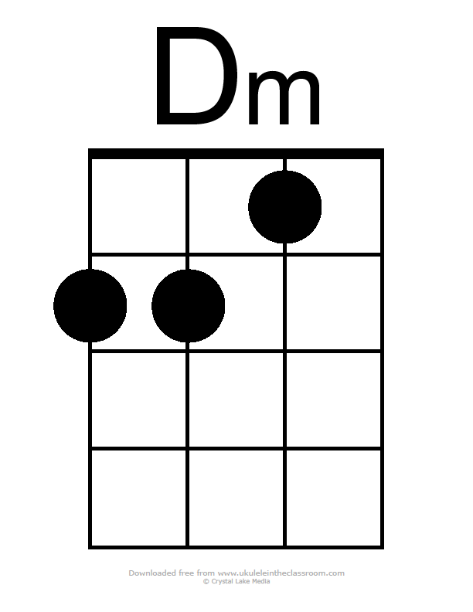
1
2
3
Be sure to use the correct
Finger numbers…
(F with a “Tuck Behind”)
D minor chord has a SAD sound

Slide 35


DRUNKEN SAILOR
X 4
Practise
Slow
Thumb
Strums -
(Verse)
X 4
X 4
X 2
X 2

Slide 36
DRUNKEN SAILOR
X 4
Practise
SHUFFLE
OR
COUNTRY
STRUM
(Chorus)
X 4
X 4
X 2
X 2

Slide 37




Slide 38



