Slide 1
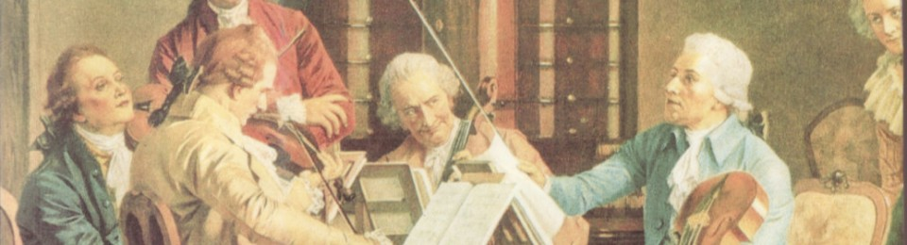
A Brief History and the Classical Orchestra
Music for the Piano
The Classical Era 1750-1810
Haydn and Mozart
Symphony and Opera
Composers of the Classical Period

Slide 2
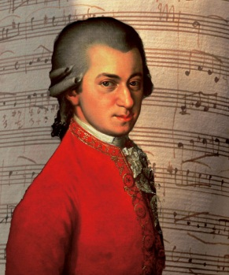

Fingerprints of the
Classical Period
Lighter clearer texture than the BAROQUE Period, less complicated:
mainly HOMOPHONIC but POLYPHONIC writing is not forgotten.
An emphasis on grace and beauty of melody and form
More variety and contrast within a piece: of keys, tunes, rhythms and
dynamics (now using crescendo and sforzando): frequent changes of
mood and timbre.
Melodies are shorter than that of the BAROQUE Period, with clear
cut phrases and clearly marked CADENCES.

Slide 3
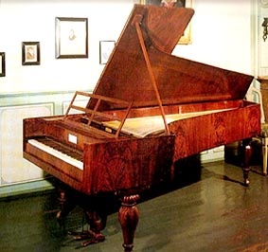
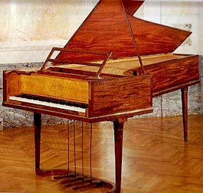
Fingerprints of the
Classical Period
The orchestra increases in size and range.
The HARPSICHORD falls out of use and the WOODWIND
becomes a self contained section.
The HARPSICHORD is replaced by the
PIANO: early piano music is quite thin in
texture, the ALBERTI BASS
accompaniment is common with Mozart
and Haydn.
Later in the period the
texture becomes richer
and more powerful with
Beethoven.
More importance is given to instrumental music –
SYMPHONY and CONCERTO.

Slide 4
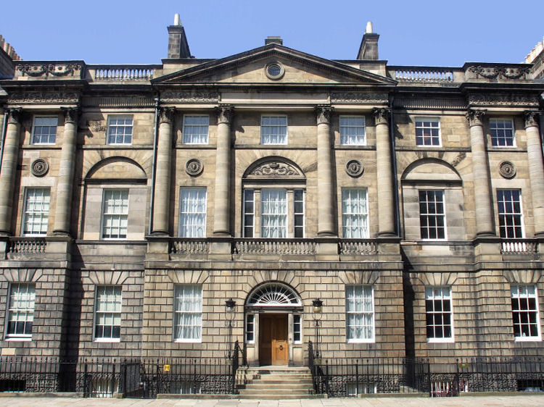
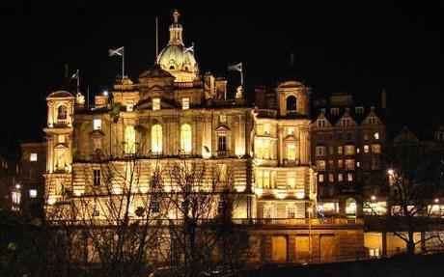
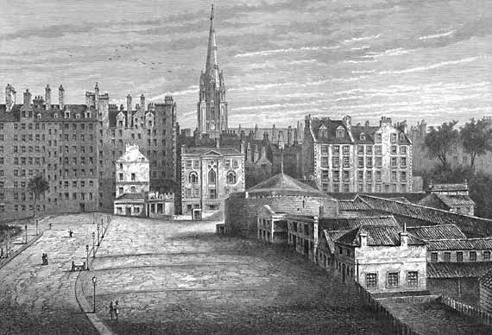
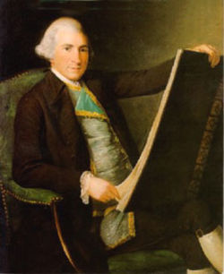
The Classical Period
Architecture
Charlotte Square in Edinburgh designed by Robert Adam
The Mound in Edinburgh was
constructed in 1763

Slide 5
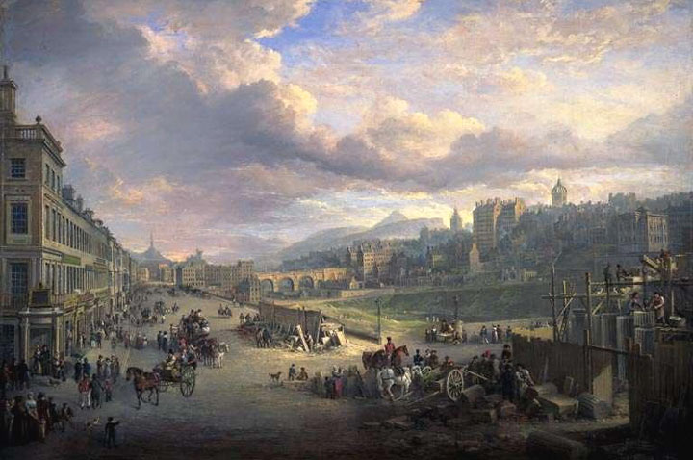
The Classical Period
Architecture
Princes Street in Edinburgh constructed from 1710 onwards

Slide 6
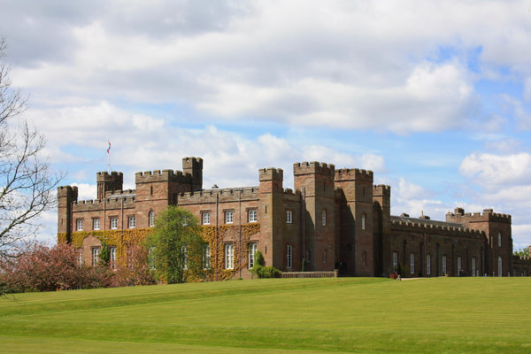
Scone Palace (Perth) – where the Kings of Scotland were crowned. It was re built from at 16th Century palace from 1808 onwards.

Slide 7
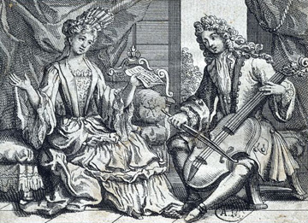
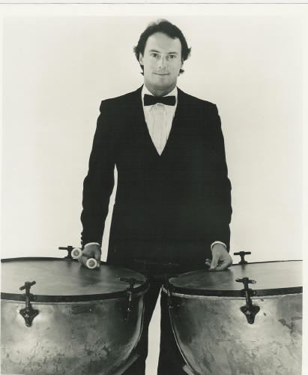
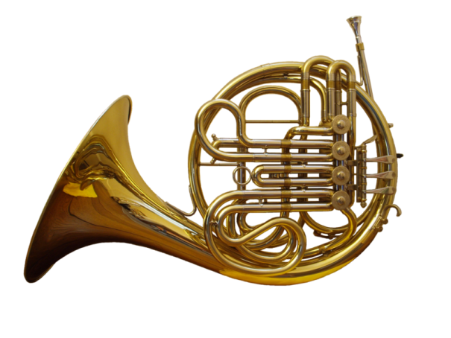
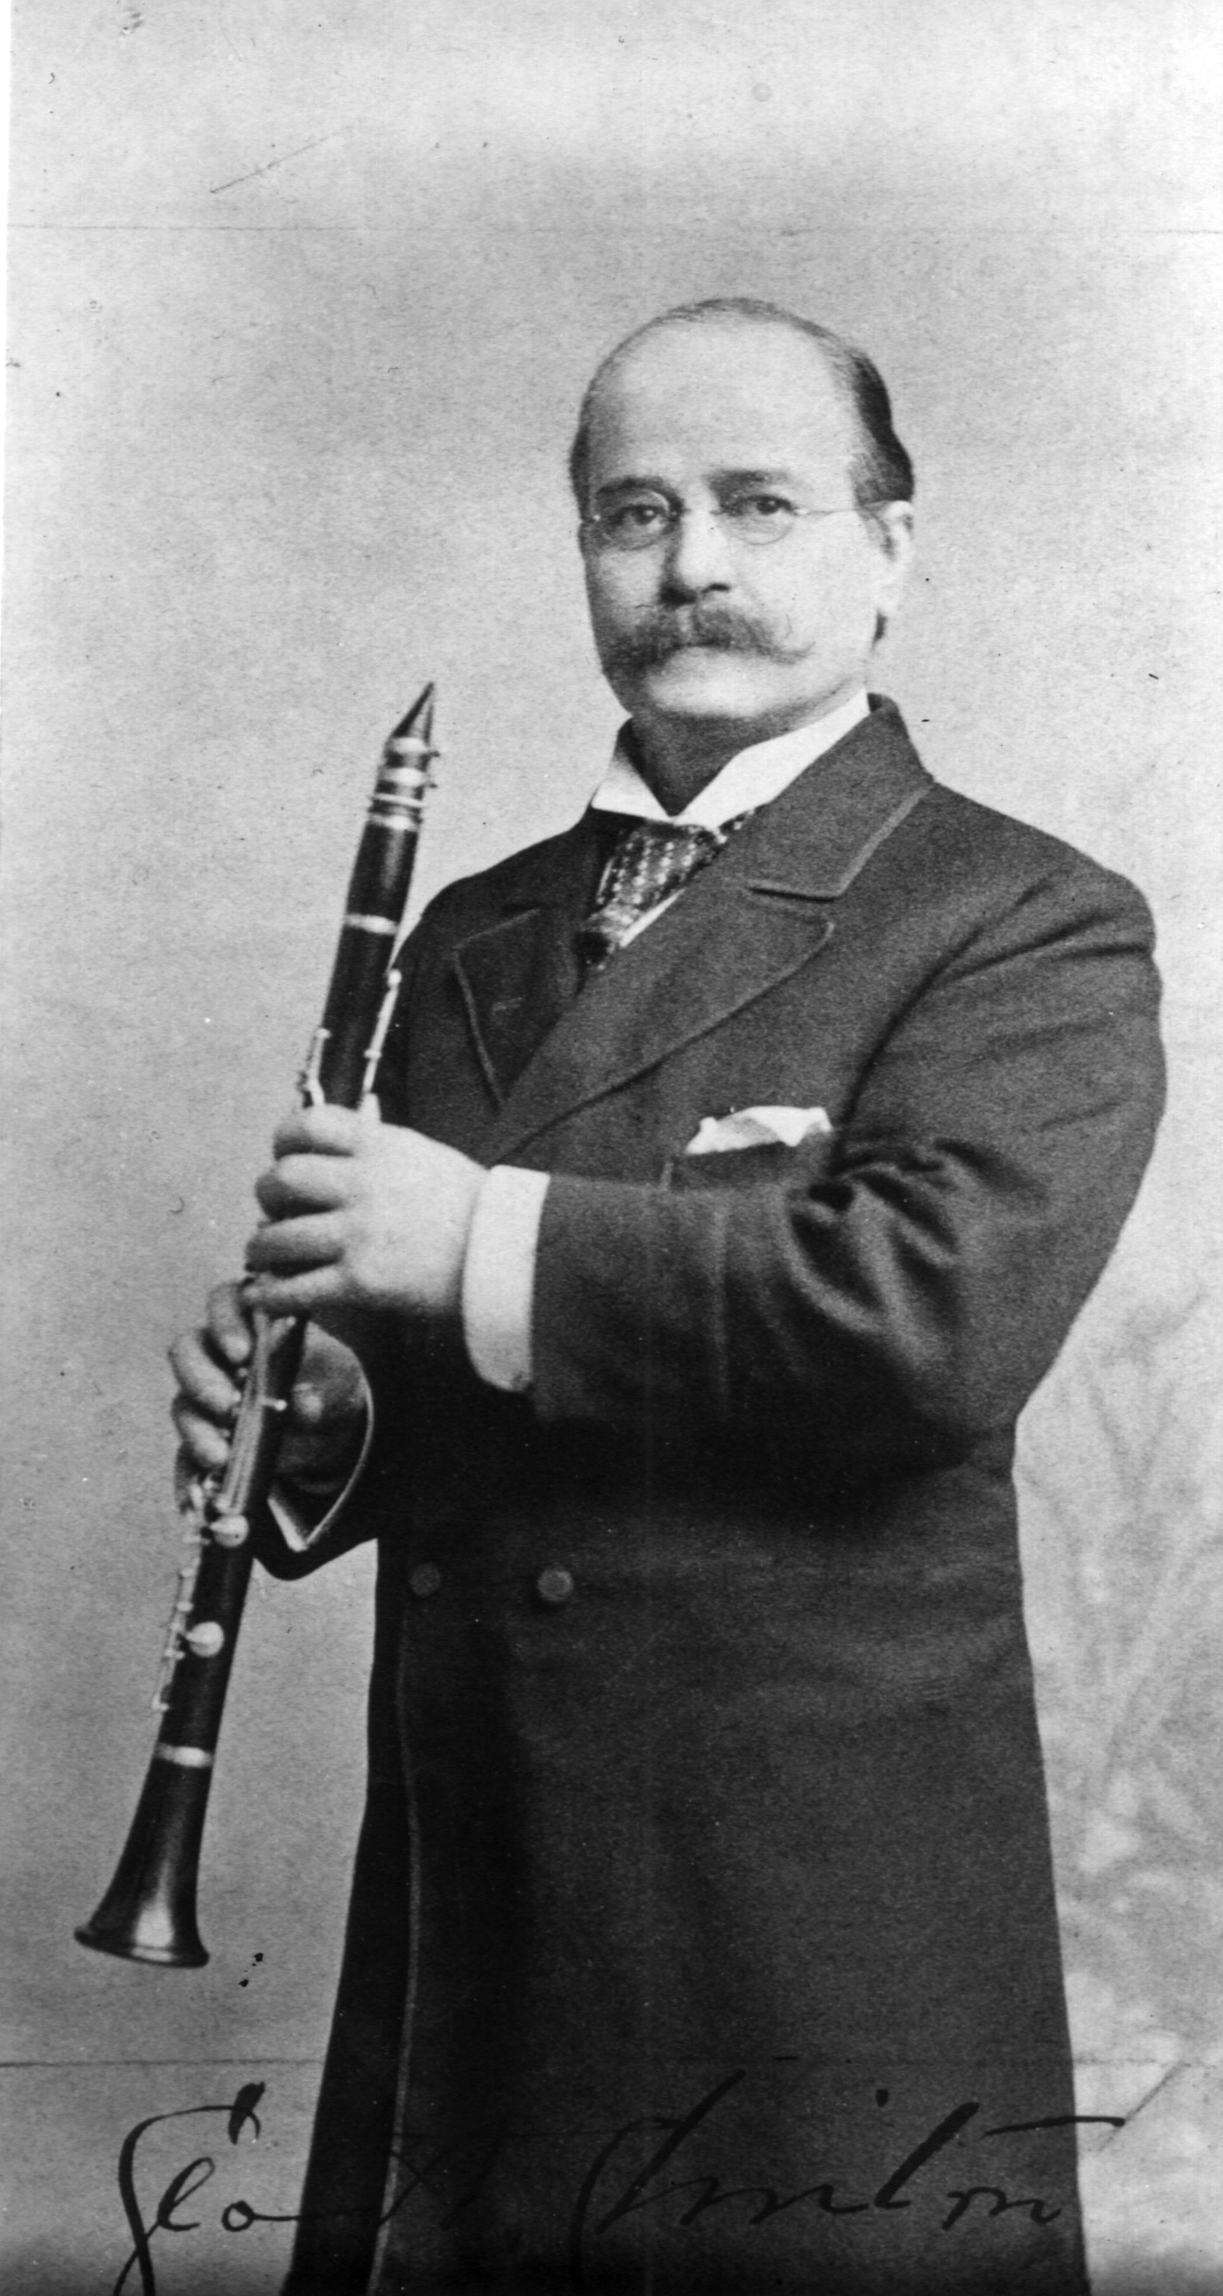
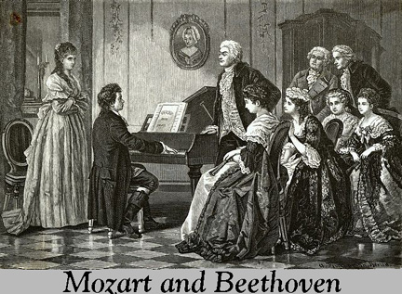
The Classical Orchestra
The orchestra, which
had begun to take shape
in the Baroque Period
began to grow.
In the early CLASSICAL Period
the ORCHESTRAS were small:
strings, 2 horns, flutes, oboes and
bassoons, occasionally 2 trumpets and
a pair of timpani.
Clarinets found a
place towards the
end of the 18th
century-the
Woodwind was now
a self-contained
Section of the
orchestra.
The HARPSICHORD
was still in use but it
gradually disappeared
as composers began to
use the wind and
horns to replace it.

Slide 8
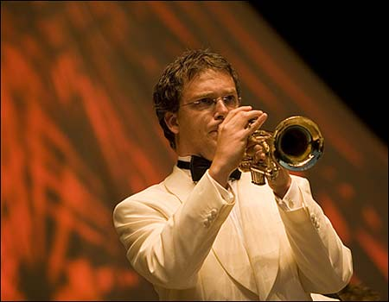
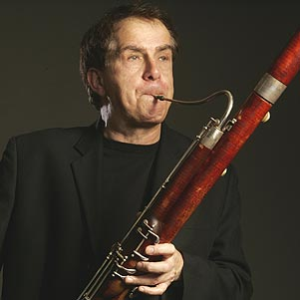

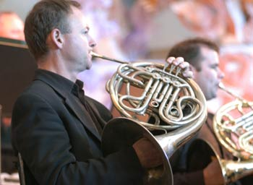
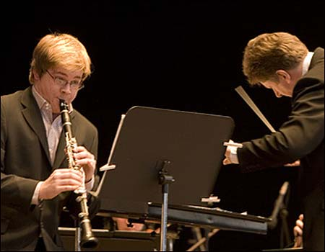

The Concerto
A CONCERTO is written in three movements: (fairly fast – slow – fast) corresponding to that of a SYMPHONY, without the MINUET.
Concerto: A piece of music written for a SOLO Instrument
accompanied by the Orchestra

Slide 9
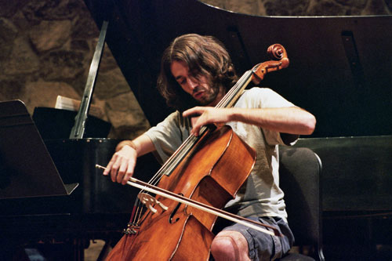
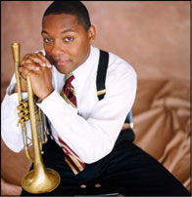
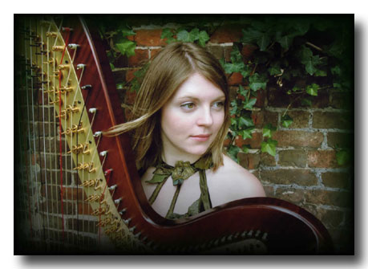

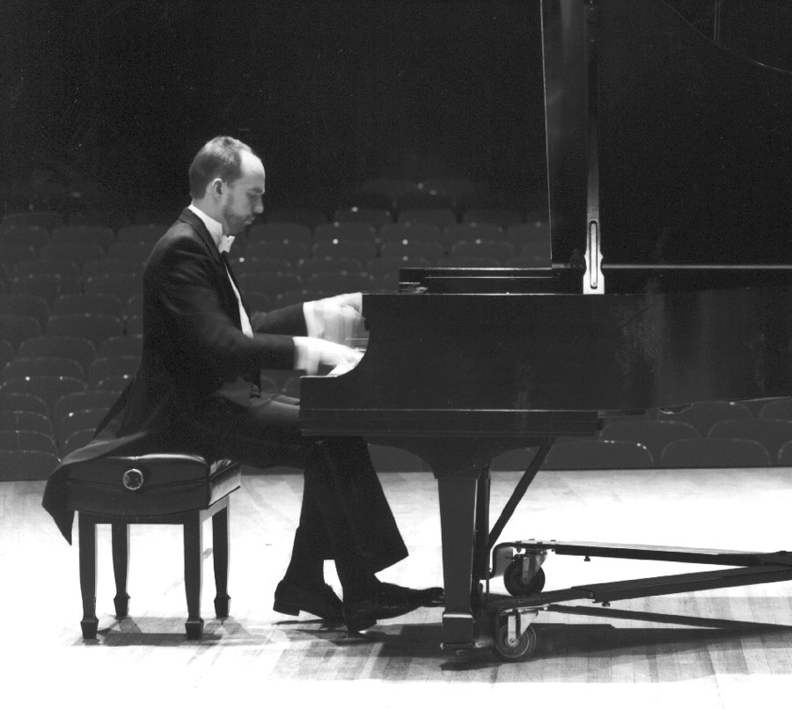
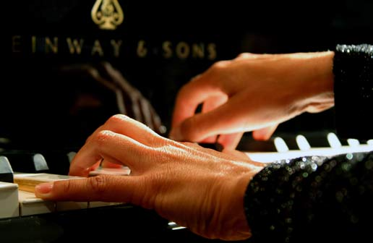
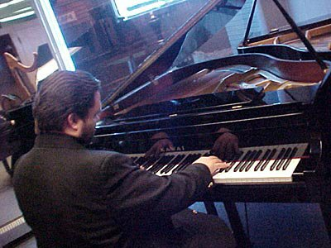

Cadenza
Towards the end of the 1st movement of the CONCERTO the
orchestra pauses and the soloist will play a CADENZA.
This is a passage of music which allows the soloist to display their technical ability which ends with a trill, a signal for the orchestra to re-enter and play the CODA (the tail i.e. the end).
Mozart Piano Concerto 21 CADENZA
Mozart Piano Concerto 21 Mov. 2
Haydn Trumpet Concerto Mov 3

Slide 10
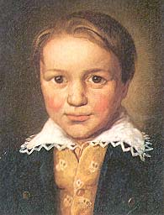
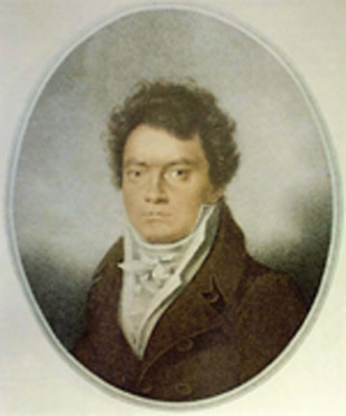
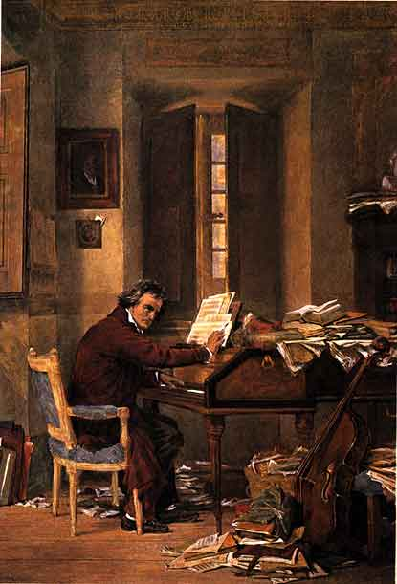
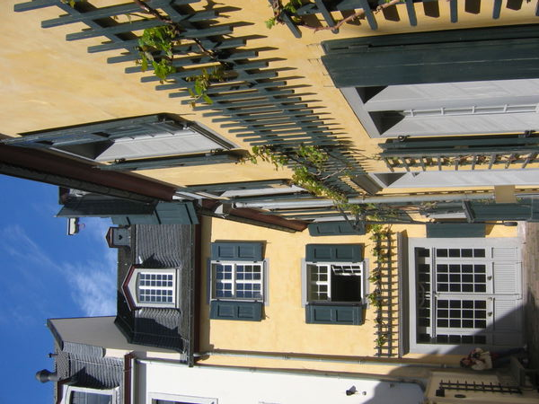
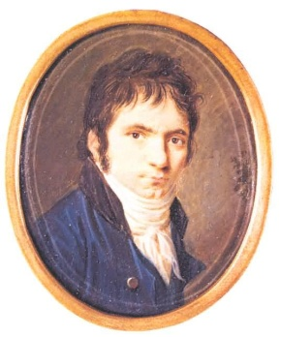
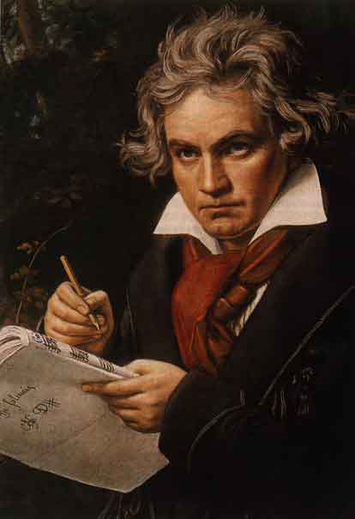
Ludwig Van Beethoven
1770-1827
Born in 1770 in Germany. Beethoven had a miserable childhood, his father (a professional singer) wanted him to become famous child musician.
So Beethoven was taught to play piano and violin from age 4. His first composition was published when he was 11. At age 17 he went to Vienna and met Mozart who predicted he would become famous. He also studied composition with Haydn for a time.
The music of Mozart and Haydn was very ‘polite’ but the music of Beethoven could take you by surprise – It was emotional and full of dramatic surprises.

Slide 11
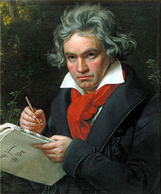
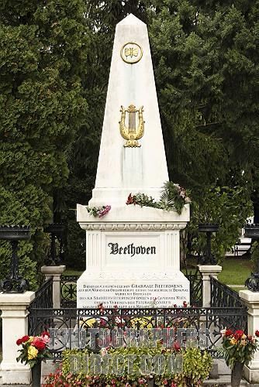
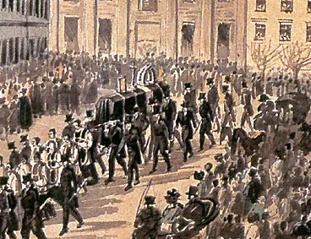

By the time he was 30,
Beethoven discovered he
was becoming deaf and
total deafness followed
soon after.
Even when totally deaf he continued to compose – only hearing in his imagination.
When, early in 1827, he died,10,000 are said to have attended his funeral. He had become a public figure, as no composer had done before. He is buried next to Schubert in Vienna.
Symphony N0. 5 By Beethoven (extract from mov.1)

Slide 12
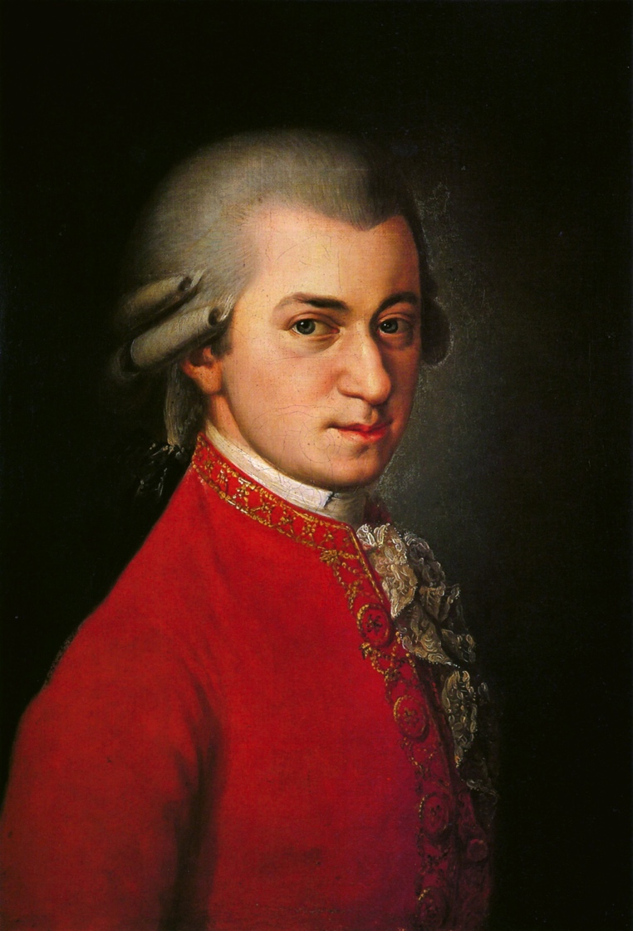
Mozart – A Brief History
Mozart a composer from the Classical Period and universally regarded as one of the most talented composers of all time.
He began composing from the age of 5 and was employed as a court musician in Salzburg at the age of 17.
He composed over 600 works and influenced later composers such as Haydn and Beethoven.

Slide 13
Listening Activity
Listen to Mozart’s Rondo Alla Turca.
What instrument is this composed for?
How many beats are in the bar?
What sort of Instrumental Techniques does Mozart use?
Is it in Major or Minor? Does it change?
What other concepts can you think of?
https://www.youtube.com/watch?v=Yomi0-WL5Pg

Slide 14
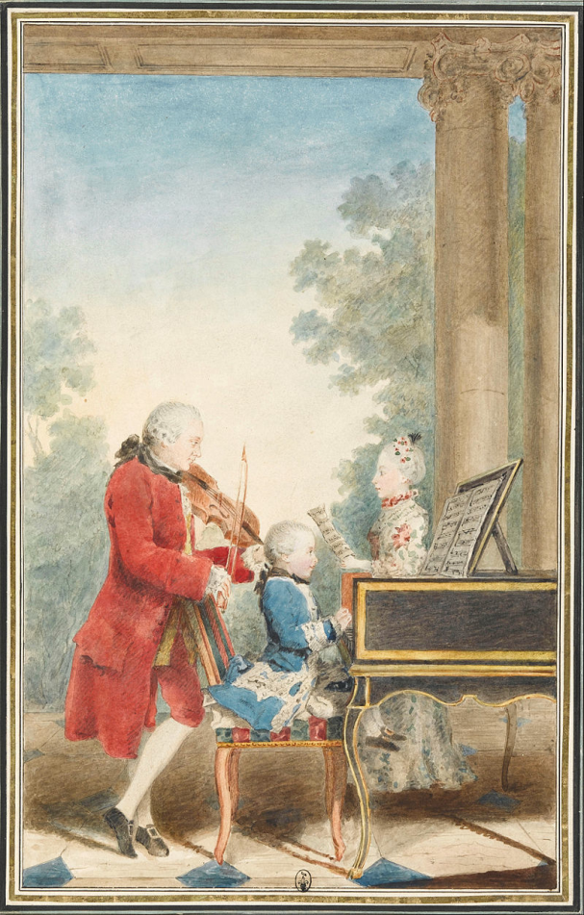
Mozart: The Early Years
From a young age, Mozart was highly competent on the violin and the piano. His father, Leopold Mozart, was a minor composer but a very experienced teacher. He taught Wolfgang and his older sister (Nannerl) to play to a high standard and they toured as child prodigies.

Slide 15
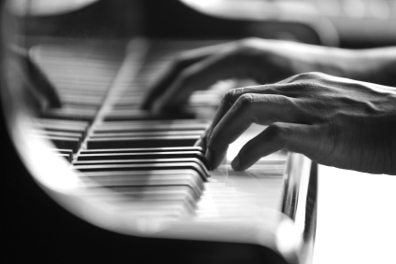

Mozart’s Compositions: Twinkle, Twinkle, Little Star
Mozart wrote Twinkle, Twinkle, Little Star at the age of 25.
It was a work for piano consisting of Theme and Variations.
Theme – This is introduced as a simple melody in the right hand, accompanied by the left.
Variations – As the piece progresses, the variations become more and more complex. This showcased Mozart’s talents as a composer and his technical ability on the piano.

Slide 16
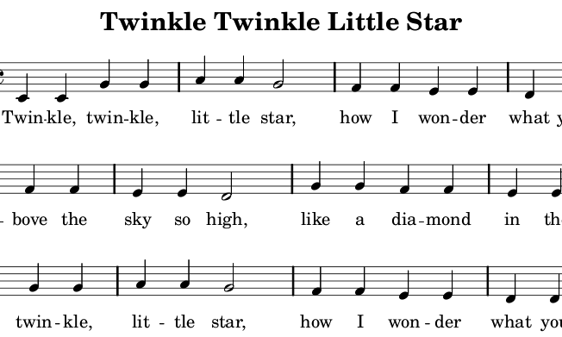
The Theme
This is the opening theme of Mozart’s Lullaby.

Slide 17
Mozart’s Compositions: Twinkle, Twinkle, Little Star
Listen to a performance of Twinkle, Twinkle, Little Star.
How many beats are in the bar?
Is it major or minor?
How would you describe the left hand accompaniment?
Are there any other concepts you can hear?
https://www.youtube.com/watch?v=bOXdAa-G4bo

Slide 18
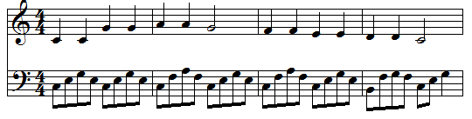
A Closer Look at the Music
The left hand creates a repeated pattern with broken chords.
It uses the notes of each chord and breaks them up.
This is a common feature of the Classical Period called Alberti Bass.

Slide 19

Theme and Variation Form
VARIATION form is one of the oldest musical designs, dating back to the very beginning of instrumental music. It first became popular with composers in the 16th century, especially with the keyboard composers of Tudor England.
THEME
As a theme, the composer chooses a fairly simple, easy to remember tune often in BINARY or TERNARY form. (The theme may be well known folk song, borrowed from another composer or composers own work).
The theme is first presented in a straightforward way. Then the music is built up by repeating the tune as many times as he likes – but each time it is altered in some way.
A A’ A’’ A’’’
Theme Variation 1 Variation 2 Variation 3 etc
A CODA may be added to the final variation to round off the whole piece.
Or the final variation may itself serve as a CODA.
Or the composer may restate the theme exactly the same way as it was first heard.

Slide 20
Theme and Variation Form
VARIATIONS
The actual number of ways in which the composer may vary his theme is
countless – limited only by the extent of his musical imagination.
Here are the some of the most important ones:
    Decorating the tune, so that it may be hidden among trills, ornaments and
    passing notes.
  A change of harmony
  A change of rhythm
A change of time signature
  A change of tempo
  A change of key i.e.. Major to minor
  Theme moved to the bass or an inner part
  Presenting the theme in a cannon (Frere Jacques) or using imitation.
  The theme itself may disappear but the harmonies or rhythms are kept so we
  are reminded of the original tune.
  A counter melody may be played above or below the theme or a new melody
  takes its place above the original harmonies.
  If the music is for orchestra a marked change in instrumentation

Slide 21
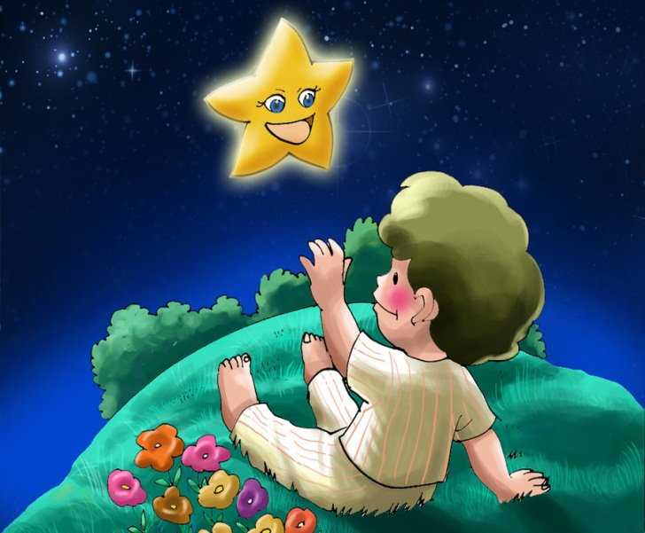
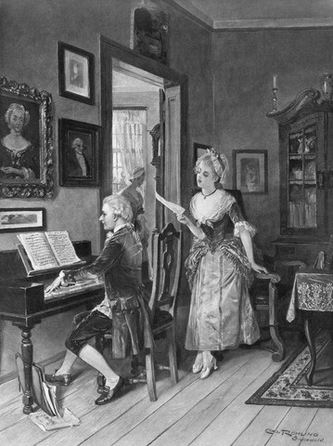
Theme and Variation Form
Theme: The well known nursery rhyme!
Variation 1: The theme is hidden among swiftly running quavers
Variation 2: The semiquavers pass down to the left hand while the theme is clearly heard in the right.
Variation 3:Triplets disguise the theme
Variation 4:The triplets move down to the bass as the theme is heard in firm chords in the right hand.
Variation 5: Note the change of rhythm

Slide 22
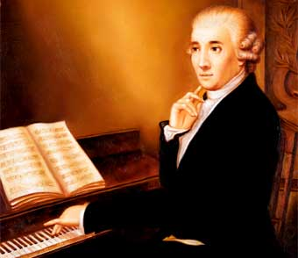

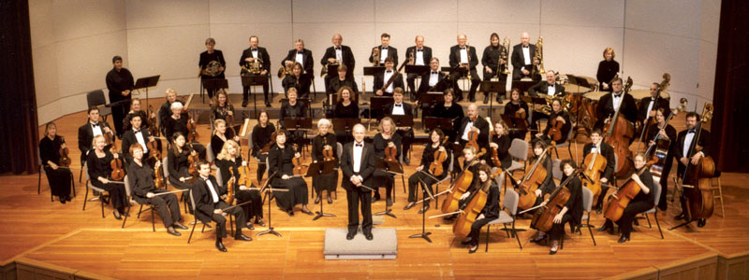
The Symphony
Haydn was one of the earliest composers to write SYMPHONIES
He wrote 104 in total and is known as the ‘father of the Classical Symphony’.
Haydn would have conducted his symphonies by himself from the harpsichord as was the fashion at that time.

Slide 23
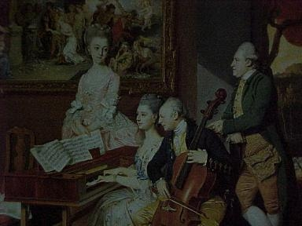

Basic plan of a
Classical Symphony
Movement One at a fairly fast tempo in
SONATA FORM
Movement Two at a slower tempo, and more song like: often in TERNARY FORM, or THEME & VARIATIONS.
Movement Three MINUTET and TRIO –Later a
SCHERZO
Movement Four (Finale) at a fast tempo, often light hearted
in mood in RONDO FORM or
sometimes THEME &VARIATIONS.
Mov. 1 Mozart Symphony No. 40

Slide 24
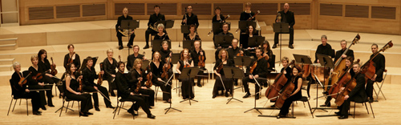
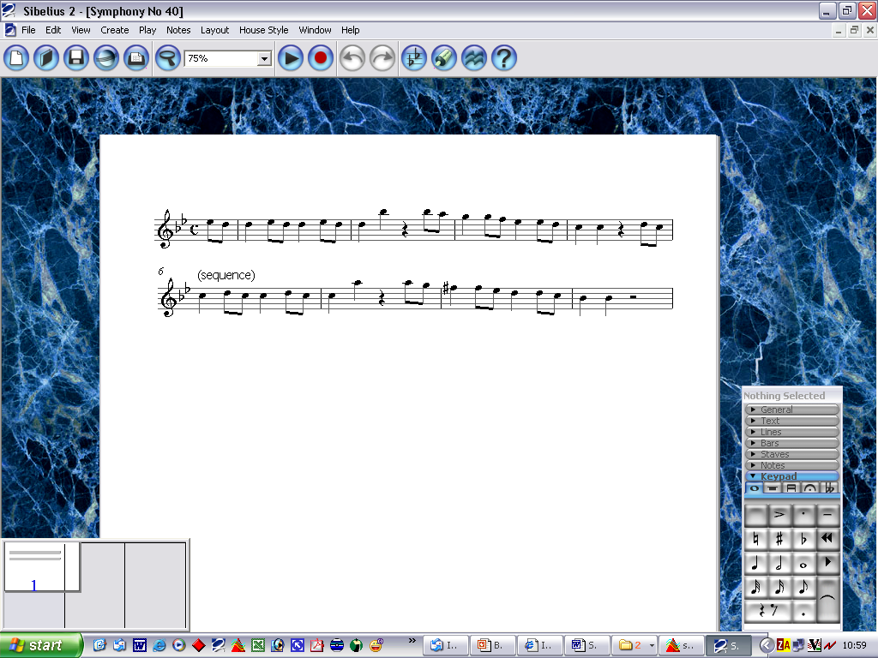
Symphony No. 40 - Mozart
One of Mozart’s most well know pieces .
A symphony is a piece of music written for the whole orchestra together. It may sound a bit like a concerto to begin with, but if you listen closely you’ll hear that a symphony does not feature a solo instrument like the concerto does. All instruments in a symphony are equal. Different instruments might get to play the melody from time to time, but no single instrument is featured throughout.
Mozart builds up the intro using sequences.
A sequence is when a short tune is repeated immediately, at higher or lower pitch.
This means that when the tune is repeated, but sounds slightly higher or lower than before. Have a look… and a listen…

Slide 25
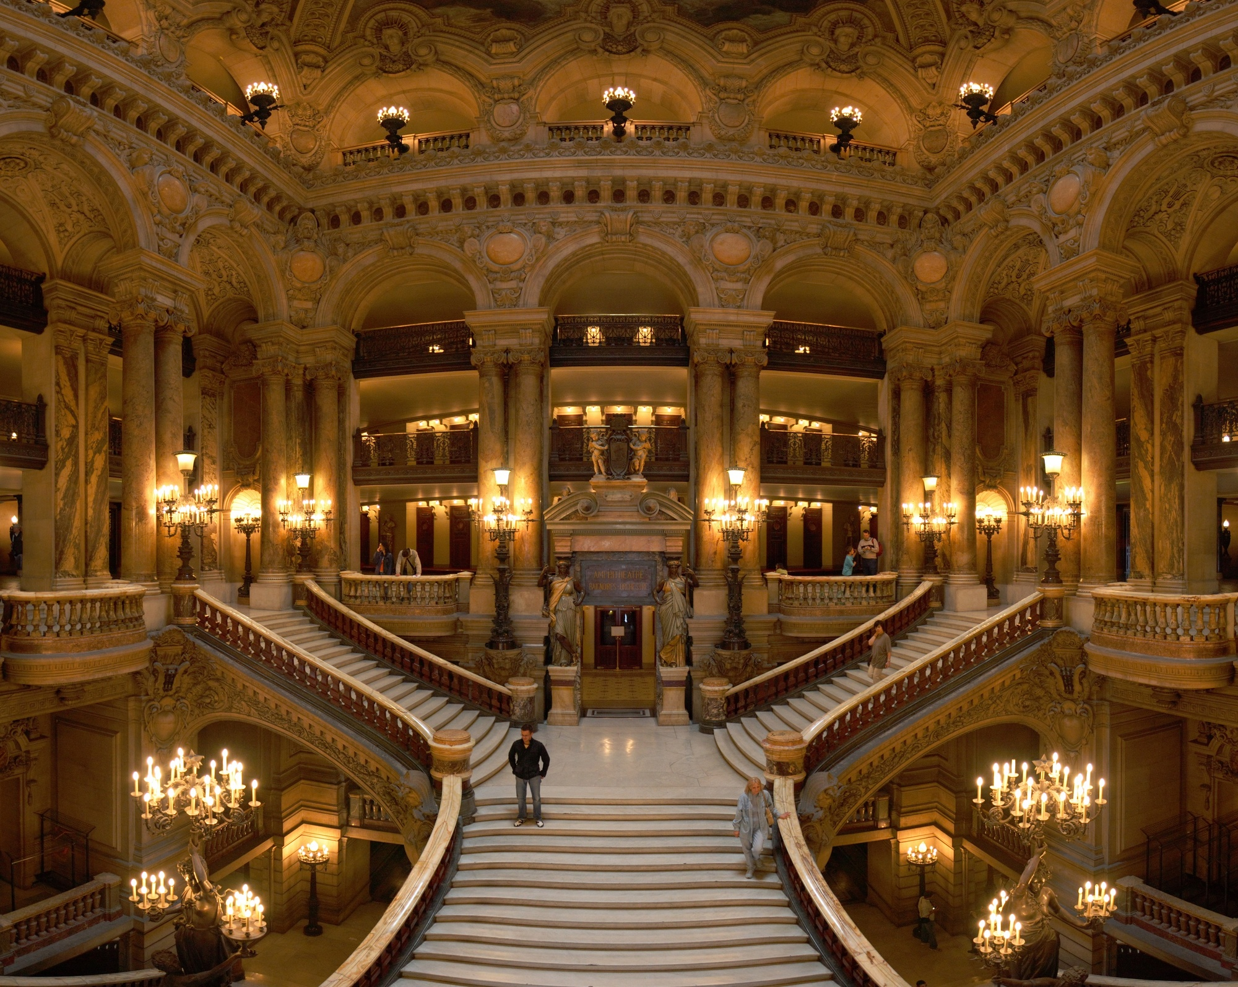
Opera
A drama set to music, acted and sung by SOLOISTS and CHORUS
and accompanied by an ORCHESTRA
ARIA
A SONG from an OPERA
CHORUS
Group of singers – all Male, all Female or Mixed Voices
DUET
A song sung by 2 people

Slide 26
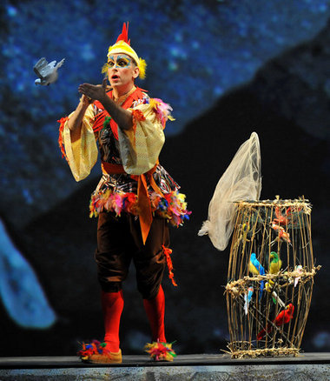
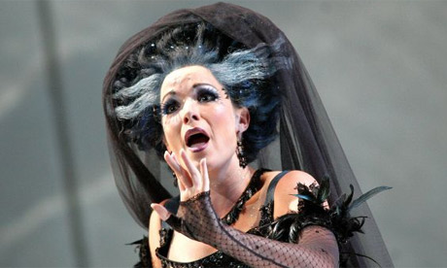
The opera was premiered in Vienna on September 30, 1791. Mozart conducted the orchestra, while the role of the Queen of the Night was sung by Mozart's sister-in-law.
‘Queen of the Night’ - An example of COLORATURA
The Magic Flute-Mozart

Slide 27
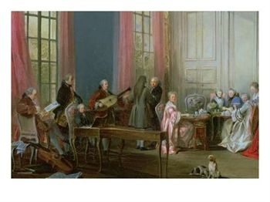




Music for the Piano
Music for instruments now became
more important than music for voices.
The pianoforte (piano) was invented as early as 1698 by Bartolomeo Cristofori in Italy.
The piano had considerable powers of
expression – loud and quiet and various
shades in-between (CRESCENDO and
DIMINUENDO, LEGATO and
STACCATO and cantabile).
It was called gravicembalo col piano e forte (a harpsichord with soft and loud).

Slide 28


Music for the Piano
At first the piano was slow to make ground, due to the crudeness of the early models.
By the 1760’s C.P.E. Bach (a son of the famous J.S Bach – he had 20 children!) accepted the piano on equal terms with the Harpsichord and Clavichord.
At this time J.C Bach (whose music greatly influenced Mozart) gave the first public performances of piano music in London.
For a while keyboard music was printed with the heading
‘For pianoforte or harpsichord’
but by the end of the 18th century the harpsichord fell out of use and was totally taken over by the piano.

Slide 29




The Sonata
A work for solo piano or solo instrument and piano
Sonata meaning ‘sounded’ was the name a classical composer gave to a work in several movements for one or two instruments only. If three instruments took part it was a trio etc.
‘Alla Turca’ from Sonata in A by Mozart
‘Moonlight’ Sonata by Beethoven
‘Pathetique’ Sonata by Beethoven - question

Slide 30


Rondo Form
In RONDO FORM, the main THEME keeps coming round.
It is like a double decker musical sandwich:
The pattern is A B A C A.
The main THEME A begins and ends in the tonic key: each episode is in a related key.
A
Main theme
B
1st Episode
a contrast
A
Repetition
of main theme
C
2nd Episode
another contrast
A
Repetition of main theme
A CODA may be added to round off the piece.
Listen to the complete ‘Rondo’ from Mozart Horn Concerto in Eb

Slide 31
Composing Skills
Alberti Bass
Broken chords played by the left hand while the right hand plays the melody.
Your task is to compose a 16 bar piece of Piano Music using Albert Bass as an accompaniment.
Open a new file in Sibelius and select PIANO as your instrument.
You will need a plan in your mind – 4 bar phrases either ABAB or AABA – its up to you
Next you need a Key Signature – C F or G Major – I hope you know these!!!!!
When you have decided on your plan and chosen a key signature you need to write a CHORD SEQUENCE – think about CANDENCES at the end of each line.

Slide 32
Composing Skills: Chord Sequence
Here is an example of a CHORD SEQUENCE using an AABA plan -
Key of C
4/4 C F C G (Imperfect Cadence ends on G)
C F G C (swapped chords at end to give V I perfect Cadence)
G Am Dm G (Imperfect Cadence ends on G)
C F G C (Perfect Cadence G-C)
In this Sibelius file is an example of a CHORD SEQUENCE using an AABA plan –
COMPOSING\ALBERT BASS COMP - CHORD SEQUENCE.sib

Slide 33
Composing Skills
Now using the Alberti Bass Technique write the Broken Chord Patterns for each bar –
COMPOSING\ALBERT BASS COMP - STAGE 1.sib
You now have 16 bars of Alberti Bass – well done!

Slide 34
Composing Skills: Writing the Melody
Now you use the notes of the Chords to compose a melody using CROTCHETS, and MINIMS. Try to think about the rhythms at the CADENCE POINTS (the end of the lines) COMPOSING\ALBERT BASS COMP - STAGE 2.sib
Passing Notes
You can if you wish add PASSING NOTES using QUAVERS (notes between the notes of the chord. COMPOSING\ALBERT BASS COMP - STAGE 3 PASSING NOTES.sib
Finishing Touches
To complete your piece how about adding some trills and grace notes?
COMPOSING\ALBERT BASS COMP - STAGE 4 ORNAMENTS.sib

Slide 35
Composing Skills: The end......
When you have completed your composition – give it a name!! And let your friends and teacher hear it.
Now export MP3 and send home via e mail. Also keep a copy of the MP3 for your Profile.

