Slide 1
Scottish Music

Slide 2
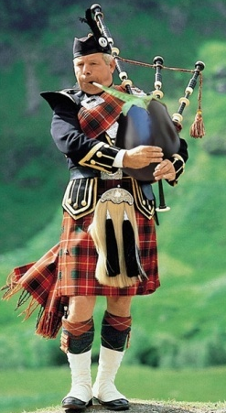
Scottish Music – What do You Already Know?
Group Discussion!
Discuss what you already know about Scottish Music and Culture.
A team member will be chosen at random to report back to the class.
Music?
Songs?
Instruments?
Dances?

Slide 3
2 Minute Timer
2:00
1:59
1:58
1:57
1:56
1:55
1:54
1:53
1:52
1:51
1:50
1:49
1:48
1:47
1:46
1:45
1:44
1:43
1:42
1:41
1:40
1:39
1:38
1:37
1:36
1:35
1:34
1:33
1:32
1:31
1:30
1:29
1:28
1:27
1:26
1:25
1:24
1:23
1:22
1:21
1:20
1:19
1:18
1:17
1:16
1:15
1:14
1:13
1:12
1:11
1:10
1:09
1:08
1:07
1:06
1:05
1:04
1:03
1:02
1:01
1:00
0:59
0:58
0:57
0:56
0:55
0:54
0:53
0:52
0:51
0:50
0:49
0:48
0:47
0:46
0:45
0:44
0:43
0:42
0:41
0:40
0:39
0:38
0:37
0:36
0:35
0:34
0:33
0:32
0:31
0:30
0:29
0:28
0:27
0:26
0:25
0:24
0:23
0:22
0:21
0:20
0:19
0:18
0:17
0:16
0:15
0:14
0:13
0:12
0:11
0:10
0:09
0:08
0:07
0:06
0:05
0:04
0:03
0:02
0:01
End

Slide 4
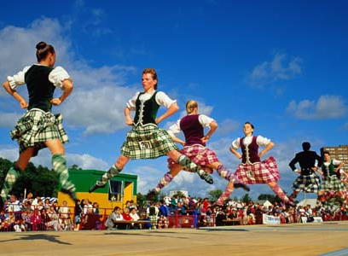
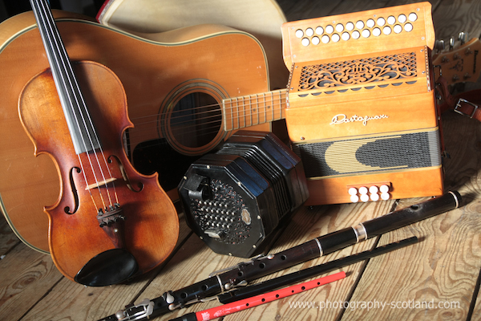
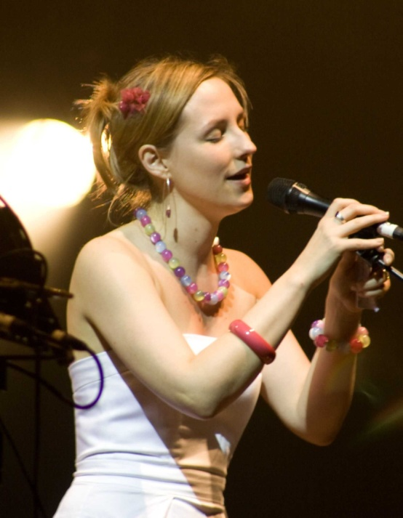
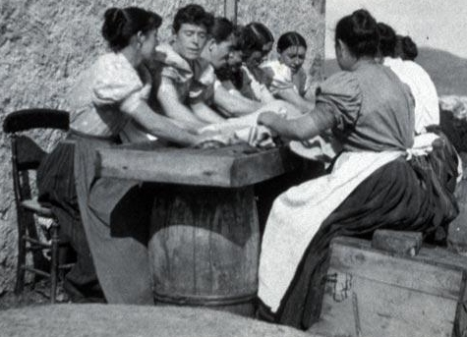
Scottish Dances
Scottish Instruments
Revision Activity
Revision
Revision
Scottish Vocal Traditions
Gaelic Vocal Traditions
Scottish Music Test
Revision
Revision

Slide 5
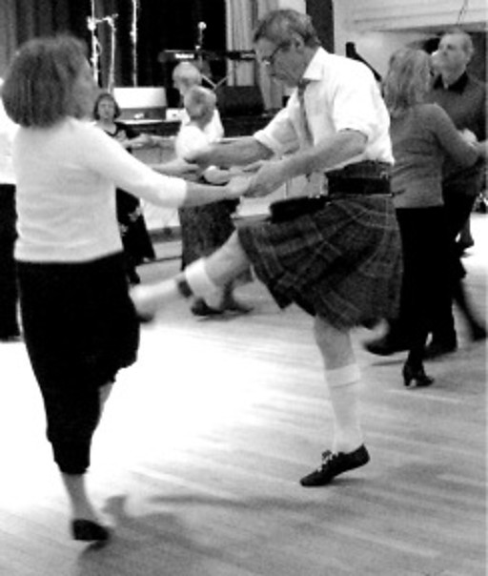
Waltz
A waltz is a slow dance with 3 beats in the bar.
The emphasis is on the first beat so the dancersknow where they are in the music.

Slide 6
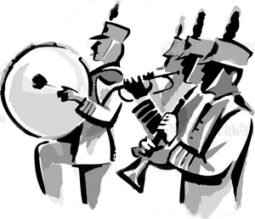
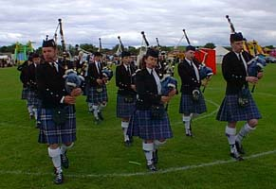
March
A March has a strong steady pulse.
It has 2 or 4 beats in a bar.

Slide 7
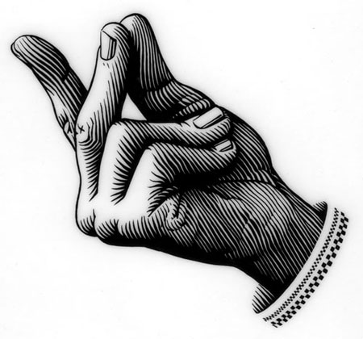
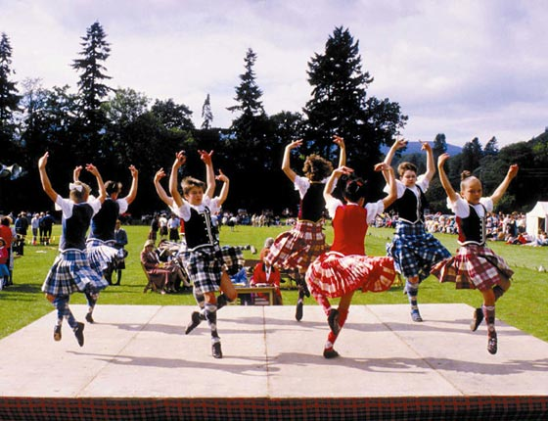
Strathspey
A Strathspey has 2 or 4 beats in a bar.
It usually features a Scots Snap.

Slide 8
Scotch Snap
A Scotch Snap is a quick, accented note before the main beat.
Most commonly found in a Strathspey.
Also known as a grace note.

Slide 9
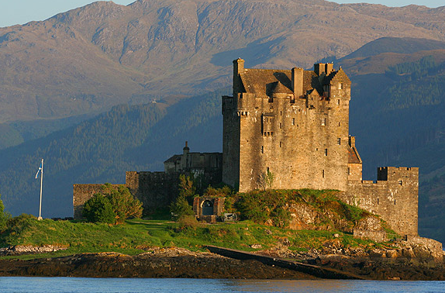
Reel
A Reel has 2 or 4 beats in a bar.
It has a fast pulse.
Reel – RUN!

Slide 10
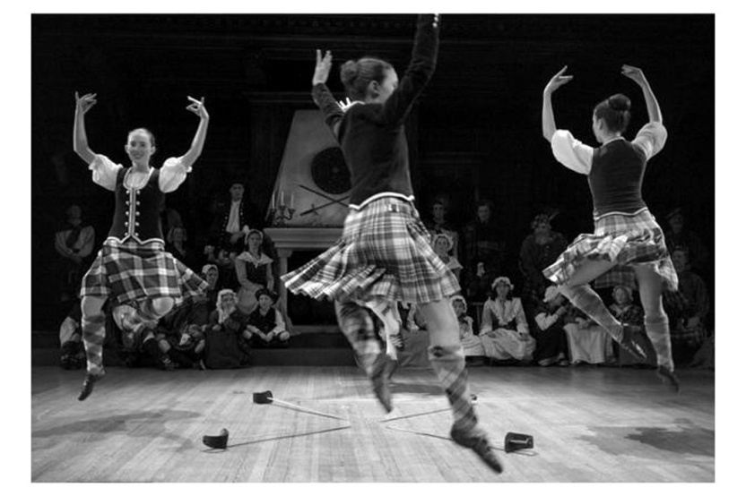
Jig
A Jig is in Compound Time- the beats are divided into three.
It has a fast flowing pulse.
Say: Jig-gi-ty, Jig-gi-ty!

Slide 11
March
4 beats in a bar featuring a Scotch Snap
Strathspey
4 beats in a bar with a steady pulse
Reel
3 beats in a bar with emphasis on the first
Waltz
4 beats in a bar with a running rhythm
Jig
In compound time with a ‘Jig-gi-ty’ rhythm

Slide 12
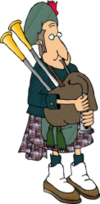
Listen Up!
Listen to the following examples of Scottish Dances.
Using prior knowledge, identify which dance is playing.

Slide 13
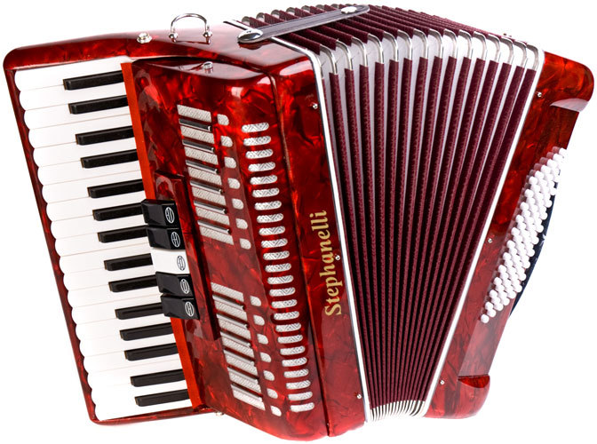
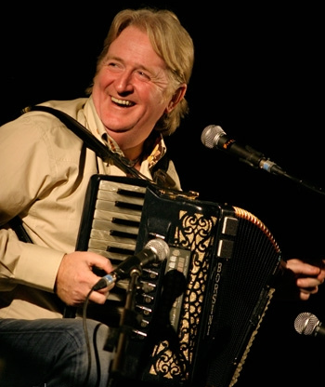
Scottish Instruments
Accordion
A keyboard instrument with buttons on one side and a keyboard on the other.
The buttons, called bases, supply the chords and the keyboard supplies the melody.
Often found at Ceilidhs, or in Folk Groups.

Slide 14
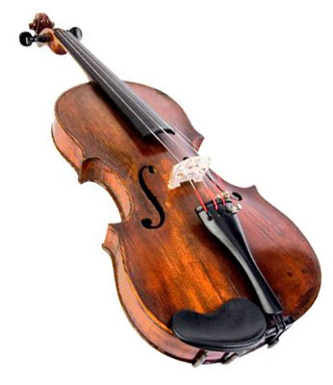
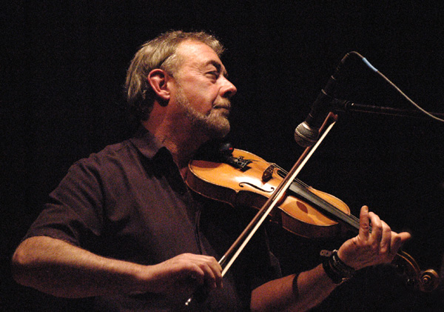
Scottish Instruments
Fiddle
A string instrument used in Scottish Music.
Has four strings and is played with a bow or by plucking the strings.
Is also known as a Violin in other styles of music.

Slide 15
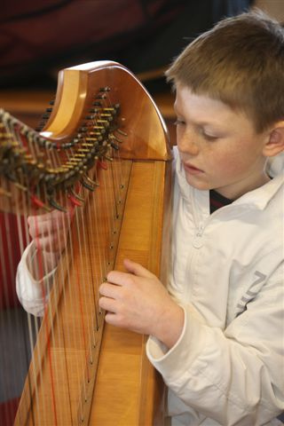
Scottish Instruments
Clarsach
A small Scottish Harp.
Clarsach is Gaelic for Harp.
Often found in Folk Music or Groups.

Slide 16
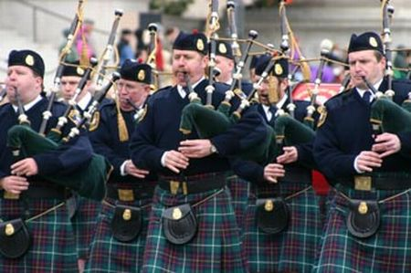
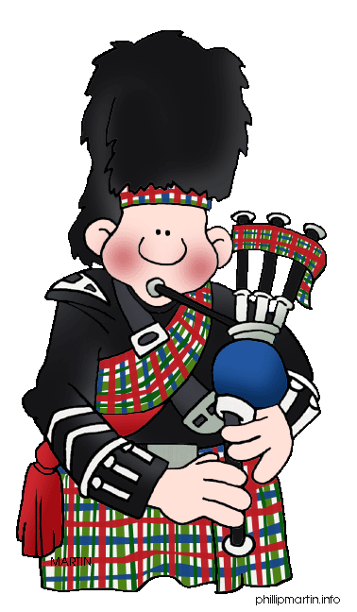
Scottish Instruments
Bagpipes
One of the most famous Scottish Instruments.
Operated by blowing into one of its four pipes.
Often found at Ceilidhs, Weddings, Folk Groups and Special Scottish Events.
DRONE
PIBROCH

Slide 17
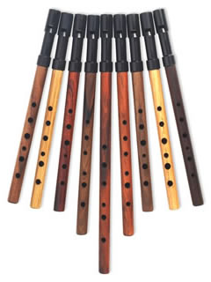
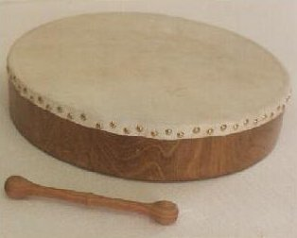
Scottish Instruments
Penny Whistle
Bodhran

Slide 18
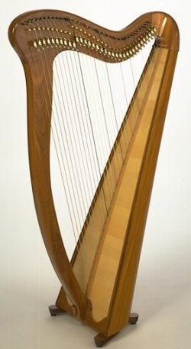
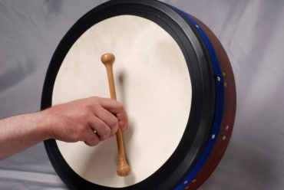
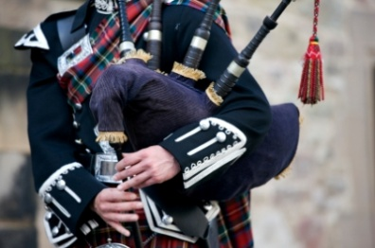
Think Fast!
Can you remember the names of these Scottish Instruments?
Fiddle
Bodhran
Clarsach
Accordion
Bagpipes

Slide 19
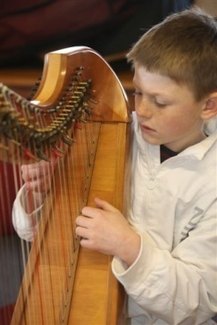
Listen Hear!
Listen to the following examples of Scottish Music.
Identify the different Scottish Instruments you hear.

Slide 20
Listen Hear!
Listen to this example of Scottish Music.
Note down all of the concepts you hear.

Slide 21
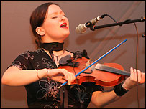
Scots Ballad
Slow song sung in English
Usually sung by a woman- but not always!
Usually about Sadness, Love and Loss
Strophic Form
Can contain more than 17 verses!!!

Slide 22
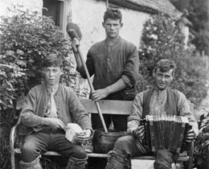
Bothy Ballad
Sung in English
Usually about farming or farm life
Singing tradition that originated from Aberdeenshire
Strophic including nonsense chorus – so other farm workers could join in

Slide 23
Gaelic Psalm
Sung in Gaelic
Unaccompanied
Features a caller
Still sung in churches today
http://www.youtube.com/watch?v=k3MzZgPBL3Q

Slide 24
Puirt a Beul (Mouth Music)
Sung in Gaelic
Uses Gaelic or nonsense words
Imitates Scottish Instruments

Slide 25
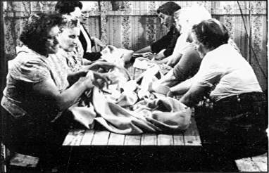
Waulking Song
Usually sung by women (but not always!) in Gaelic
Sung as the women stretched tweed
Unaccompanied
The Woman kept the beat by
stamping their feet
Featured Call and Response

Slide 26
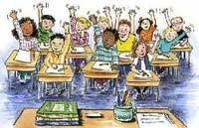
Carousel Activity
Your teacher will split you into four groups.
In these groups, you will be given a large piece of paper with a heading.
In groups, write down as many concepts as you can for that heading.

Slide 27
SCOTTISH INSTRUMENTS
SCOTTISH DANCES
SCOTTISH VOCAL MUSIC (GAELIC)
SCOTTISH VOCAL MUSIC (SCOTS)

Slide 28
MALE
MUM
DAD
FEMALE
MY FAMILY
FEMALE
JOHN
ANN
MALE

Slide 29
2:00
1:59
1:58
1:57
1:56
1:55
1:54
1:53
1:52
1:51
1:50
1:49
1:48
1:47
1:46
1:45
1:44
1:43
1:42
1:41
1:40
1:39
1:38
1:37
1:36
1:35
1:34
1:33
1:32
1:31
1:30
1:29
1:28
1:27
1:26
1:25
1:24
1:23
1:22
1:21
1:20
1:19
1:18
1:17
1:16
1:15
1:14
1:13
1:12
1:11
1:10
1:09
1:08
1:07
1:06
1:05
1:04
1:03
1:02
1:01
1:00
0:59
0:58
0:57
0:56
0:55
0:54
0:53
0:52
0:51
0:50
0:49
0:48
0:47
0:46
0:45
0:44
0:43
0:42
0:41
0:40
0:39
0:38
0:37
0:36
0:35
0:34
0:33
0:32
0:31
0:30
0:29
0:28
0:27
0:26
0:25
0:24
0:23
0:22
0:21
0:20
0:19
0:18
0:17
0:16
0:15
0:14
0:13
0:12
0:11
0:10
0:09
0:08
0:07
0:06
0:05
0:04
0:03
0:02
0:01
End
2:00

Slide 30
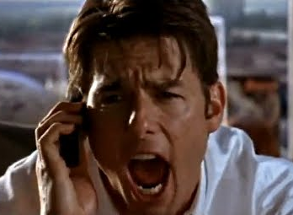
Show Me the Music!
Scottish

Slide 31
THE RULES...
Listen to the following examples of Scottish Music.
Using the Show Me Boards provided, write down the answer.
Get ready to explain why!

Slide 32
Question One
What Scottish Instrument is playing the melody?
Bagpipes Accordion
Clarsach Violin

Slide 33
Question Two
This Question features a Scottish Waltz.
How can this be identified as a Waltz?
Give two answers.
3 Beats in a Bar
Slow, Stately Pulse
Emphasis on the first beat

Slide 34
Question Three
This is an example of Scottish Vocal Music.
Write down the type of Vocal Music playing.
Gaelic Psalm Bothy Ballad
Waulking Song Mouth Music

Slide 35
Question Four
This is an example of a Scottish Dance.
Write down the Scottish Dance playing.
March Reel
Strathspey Slow Air

Slide 36
Question Five
Write Down two concepts that describe the music playing.
Fiddle Pibroch
Accordion Scotch Snap

