Slide 1
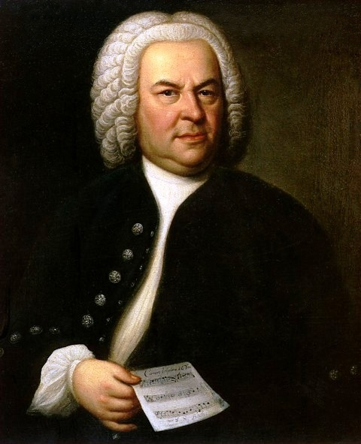
The Baroque Period
1600-1750

Slide 2
The Baroque Period – The Facts
What can you remember?

Slide 3
What are We Learning Today?
Take a closer look at the music and instruments of this period
History of the Baroque Period
Work as a class to complete the group performance
Learn about Concerto and Concerto Grosso

Slide 4
Concerto
This was a famous style of the Baroque period which took two forms:
Solo Concerto
Concerto Grosso
Each had a ripieno, concertino and a continuo part.
The first section was usually written in ritornello form.

Slide 5
Basso Continuo
This style is typical of the Baroque Period.
The harpsichord (Basso) plays chords whilst cello (Continuo) plays the melody line.

Slide 6
Forms
Binary Form – 2 contrasting sections. (AB)
Ternary Form – 3 sections, the first returning at the end. Like a musical sandwich! (ABA)
Rondo – Many new sections are introduced, but the main theme keeps returning. (A, B, A, C, A, D...)
Ritornello – “little return”. The main theme which keeps coming back in a Solo Concerto or Concerto Grosso.

Slide 7
Forms
Sonata Form
Exposition >>>>>>> Development >>>>>> Recapiculation

Slide 8
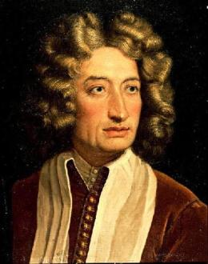
Listening Task
Have a listen to Pachabel’s Canon in D by composer Johann Pachebel.
What do you notice about:
The Bass Line?
The Melody Line?
Timbre?
Dynamics?
Any other concepts?

Slide 9
Listening Task
Have a look at Pachabel’s Canon in D by composer Johann Pachebel.
https://www.youtube.com/watch?v=090BIg0mlcY
This is a Passacaglia- variations over a Ground Bass. The Bass line is an ostinato whilst the melody line develops and changes.

Slide 10
Pachelbel’s Canon in D – Violin I
I
The key of this piece is D Major.
What notes of the key is Pachelbel using?

Slide 11
Pachelbel’s Canon in D – Violin I
These two bars are the Ground Bass. They are continually played by the cello part.
The Violin I part then plays variations (different melodies) based around this Ground Bass idea.
The same chords are repeated throughout but the variations become gradually more complicated.

