Slide 1
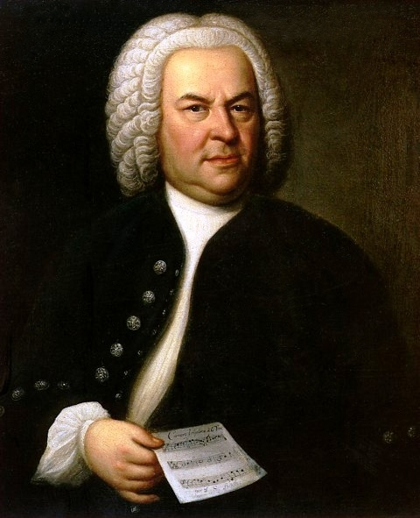
The Baroque Period
1600-1750

Slide 2
What are We Learning Today?
Learn about the Baroque Period and its influence on music
History of the Baroque Period
Develop our understanding of Opera and Oratorio
Learn about Baroque Choral Music

Slide 3
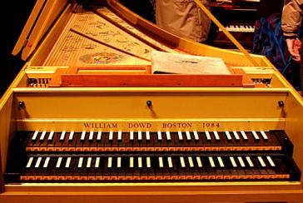
Handel
Composers
Vivaldi
J.S Bach
Baroque Period
Ternary
Instruments
Forms
Rondo
Harpsichord
Binary

Slide 4
The Baroque Style
Listen to Vivaldi’s Four Seasons.
What was the Baroque style like?
What string techniques are being used?
What is the tonailty?
Can you hear any other concepts?

Slide 5
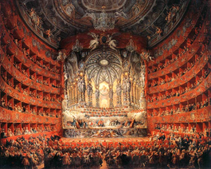
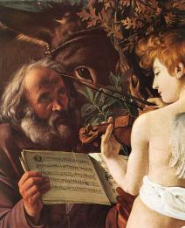
The Baroque Style
Music in the Baroque Period was usually very polyphonic in texture and used elaborate ornaments. There was close attention to detail in composition.

Slide 6
Choral Music
Opera
Oratorio

Slide 7
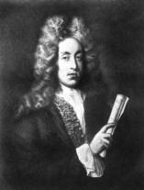
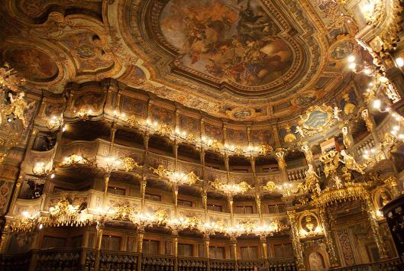
Choral Music
Opera
Non-religious vocal work
Contain singer, chorus, scenery, staging and accompanying instruments
Extravagant costumes

Slide 8
Choral Music
Opera
Henry Purcell was a famous composer of the Baroque era
Composed music for plays (A Midsummer Night’s Dream)
One of his most well-known works was Dido and Aeneas- one of his only operas

Slide 9
Choral Music
Listen to “Dido’s Lament” from Dido and Aeneas.
https://www.youtube.com/watch?v=PeB4cpRq16M
In this legend, Dido is the Queen of the Romans. At this point in the Opera, her love Aeneas has abandoned her and she is heartbroken.
This song comes after a brief recitative secco.
What concepts can you identify?
Tempo?
Timbre?
Word Setting?
Melody/Harmony?
Voice Type?
With score:
https://www.youtube.com/watch?v=uGQq3HcOB0Y

Slide 10
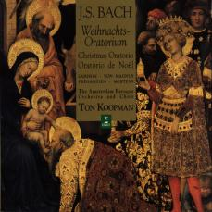
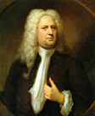
Choral Music
Oratorio
The first oratorios started to appear at the start of the Baroque period and in many ways were little different from the first operas.
Although they were religious works they contained solo singers, chorus, scenery, staging and accompanying instruments.
As the first great oratorios appeared in the early 18th century the works were performed as concert pieces with soloists, chorus and orchestra.

Slide 11
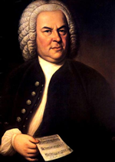
Choral Music
Mass
In the Baroque period many composers wrote Masses and perhaps the most outstanding of these is the Mass in B Minor by J S Bach.
Which section of the Mass is this example from?

Slide 12
Choral Music
Cantata
A smaller version of a Mass- usually only 15 to 30 minutes in length
Bach was a prolific composers of cantatas due to his role at St Thomas’ Church
These sometimes included Chorales

